Slide 1
Three Types of MDBs
Tom Waters
DIS Membership meeting
September 6, 2025

Slide 2
Type I
Typical Parentage: SDB X SDB
  (one or both parents may also be a type I MDB)
Short selections from SDB breeding
About 90% of recent MDBs
Full range of color and pattern found in SDBs
Easily grown even in mild-winter climates ( ~ zone 8)
Chromosome configuration PPTT (half pumila, half TB; 40 chromosomes)
Fully fertile
Tend to bloom later than other MDBs, often in SDB season
Often near the maximum height limit, can grow out of class

Slide 3
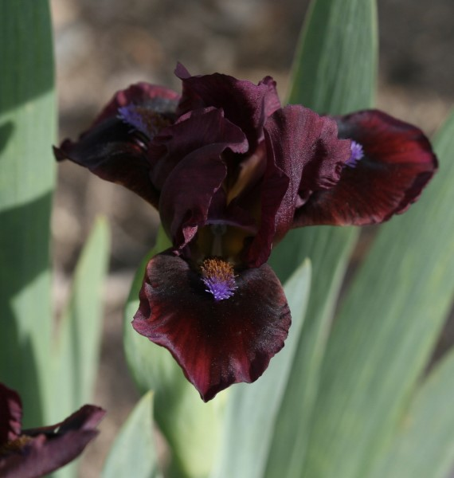
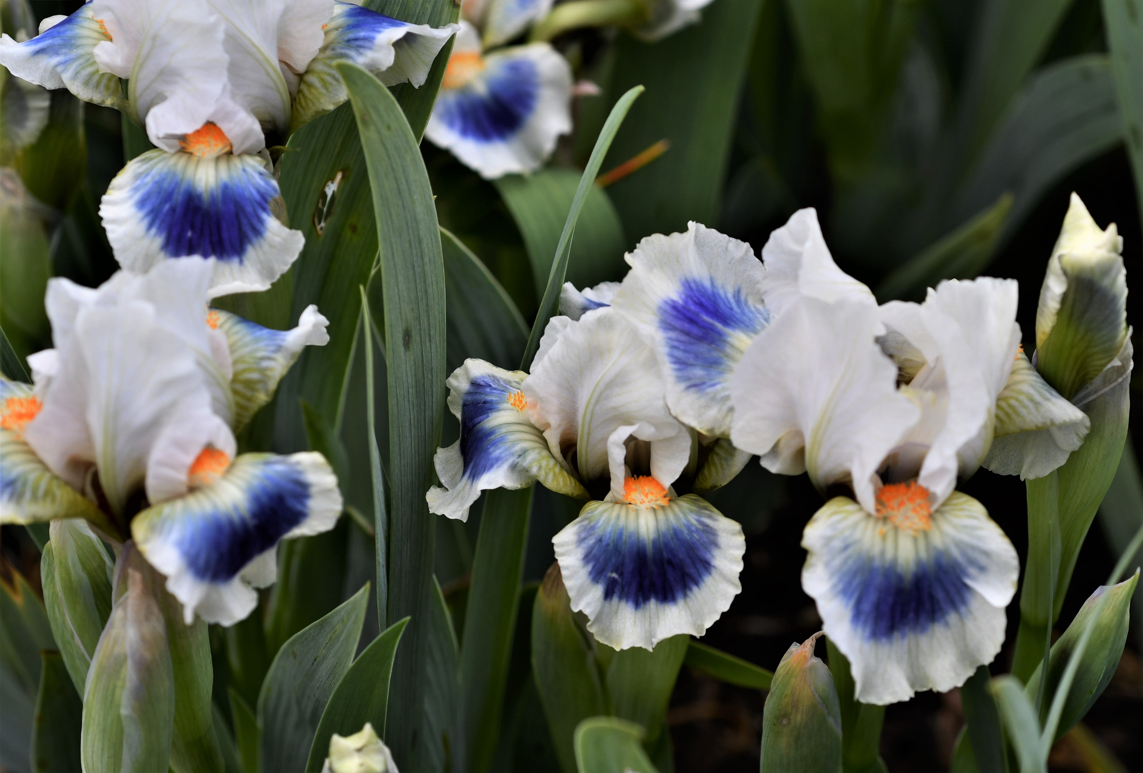
African Wine
Alas
(Kasperek, 1999)
(Johnson, 2014)

Slide 4
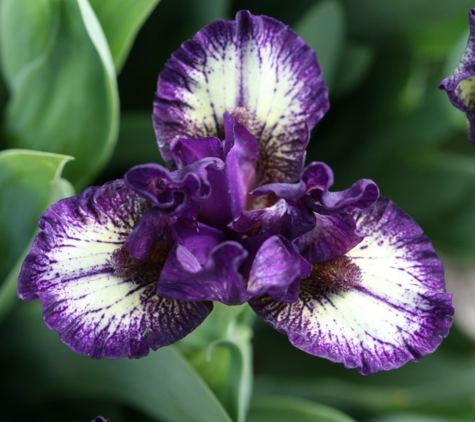
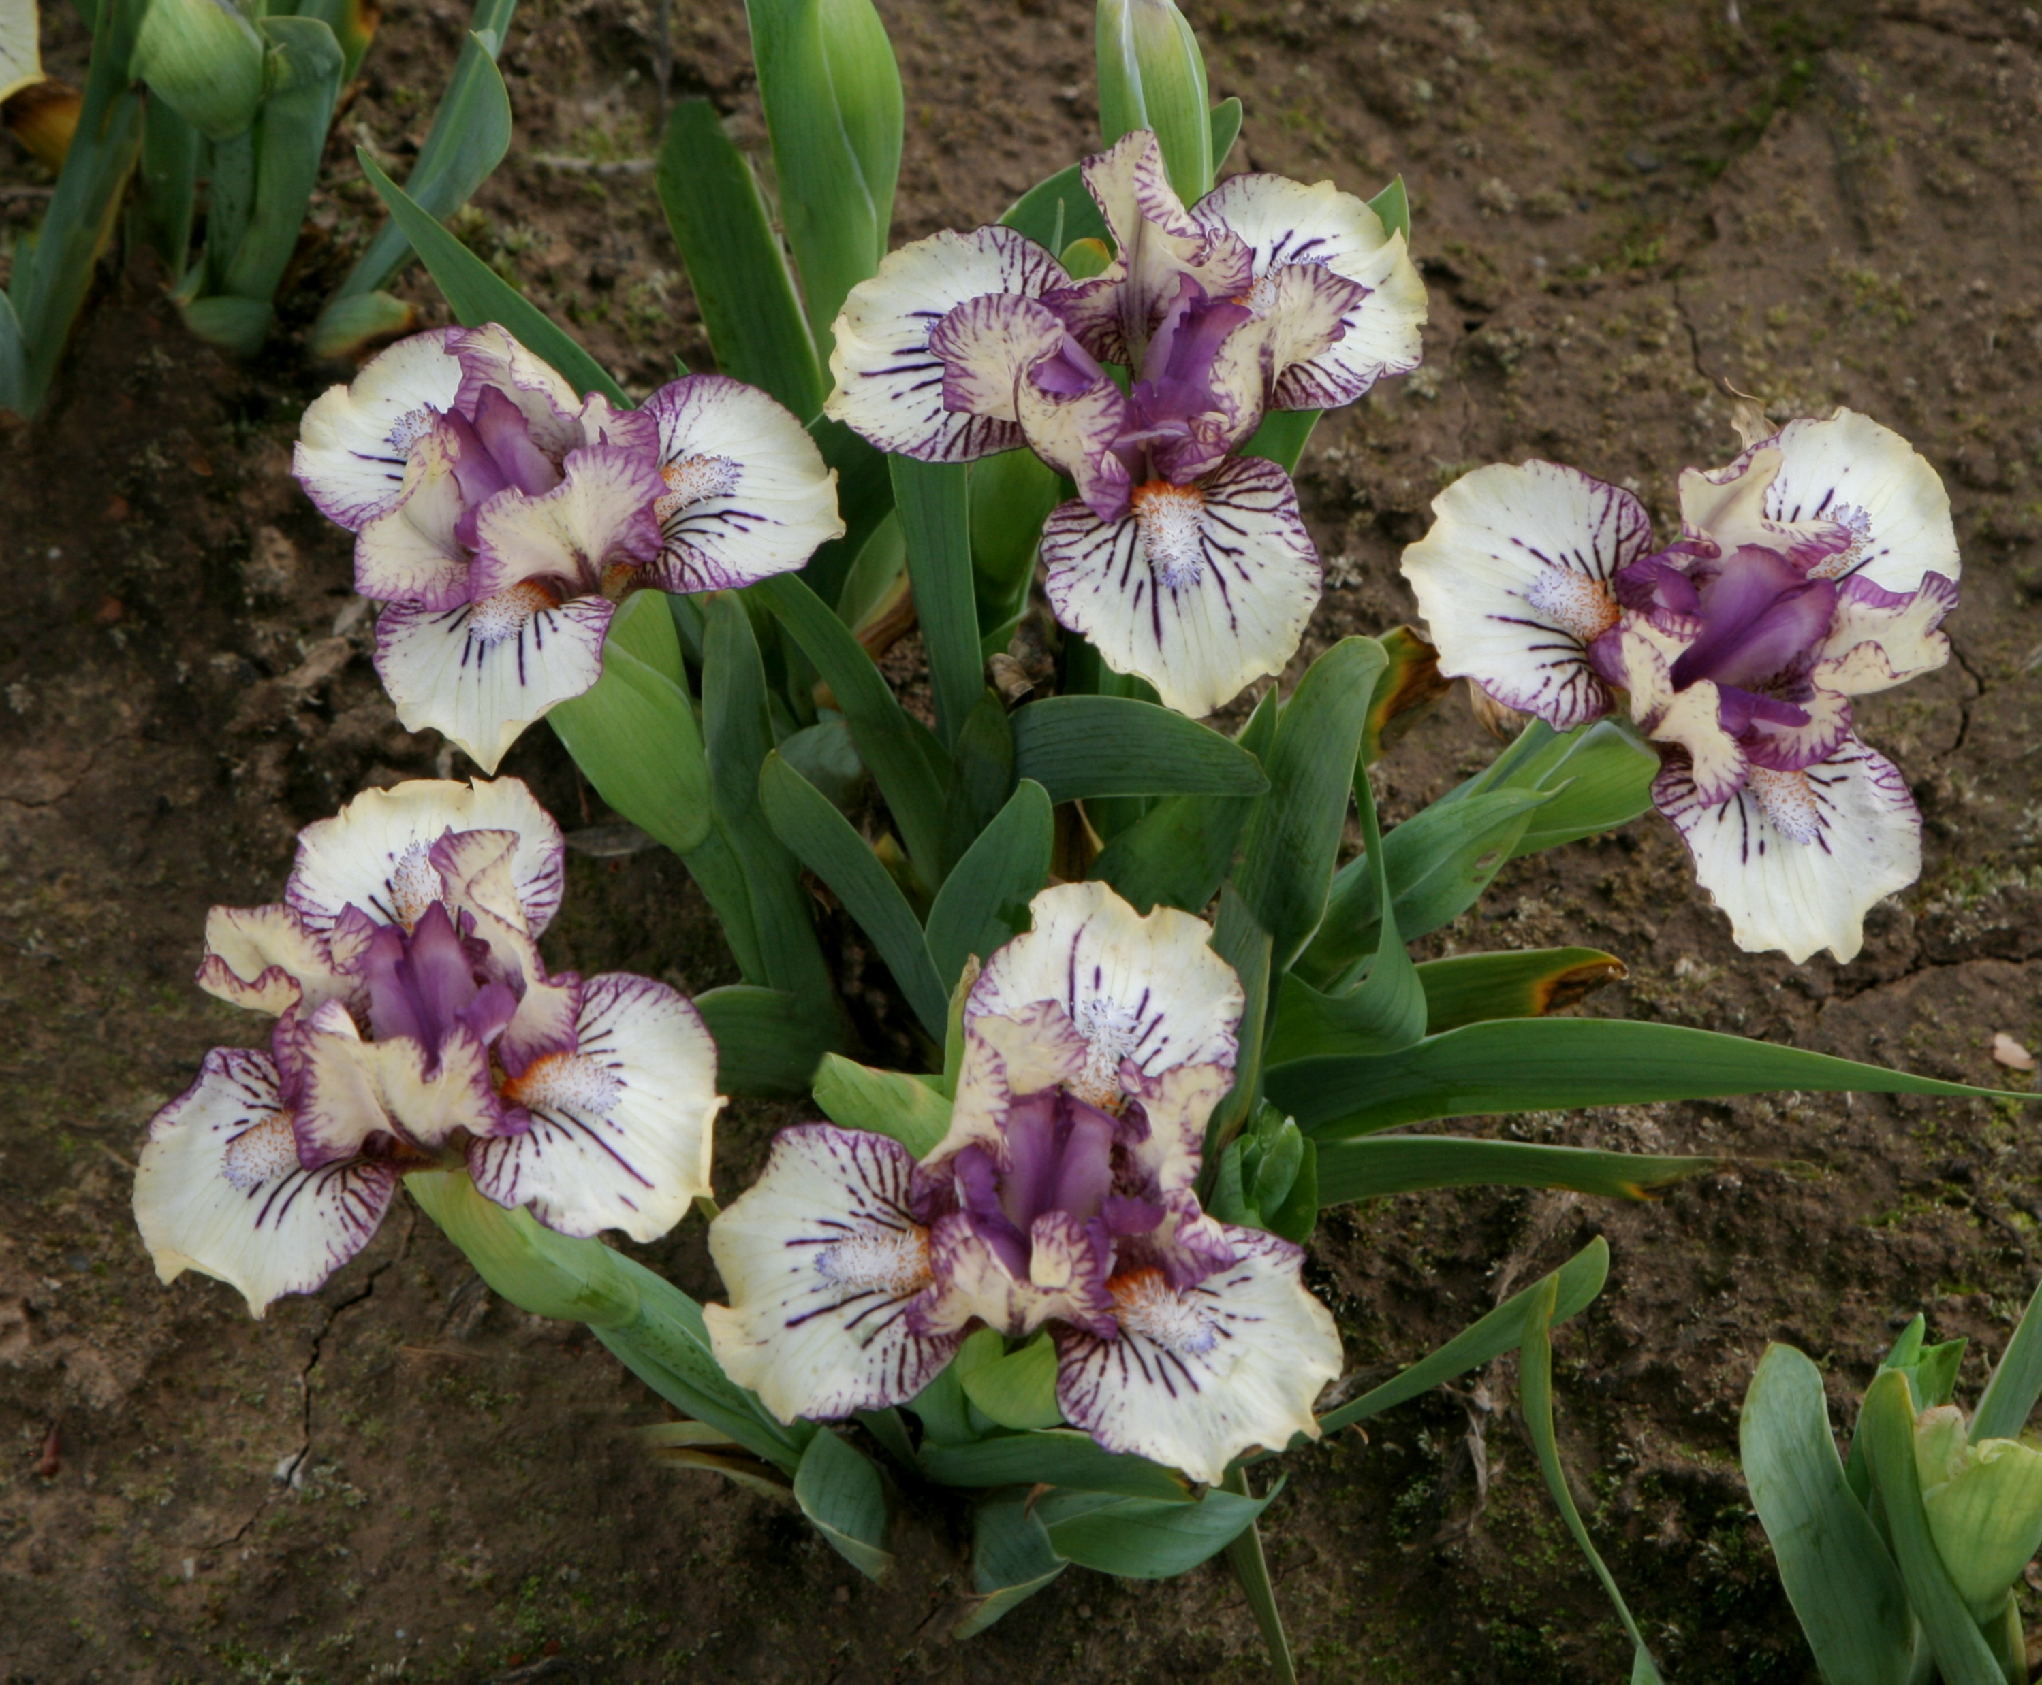
Be Brief
Beetlejuice
(Black, 2008)
(Black, 2013)

Slide 5
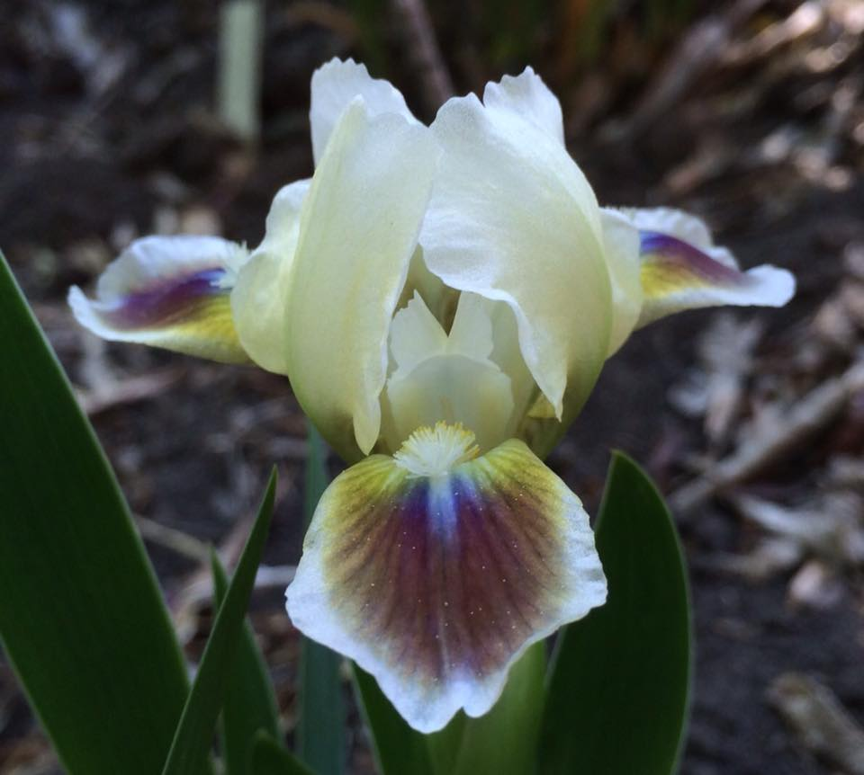
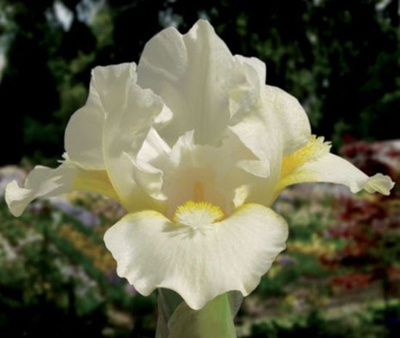
Ditto
Dollop of Cream
(Hager, 1982)
(Black, 2006)

Slide 6
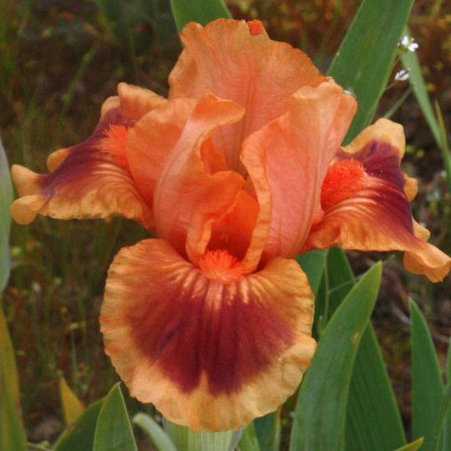
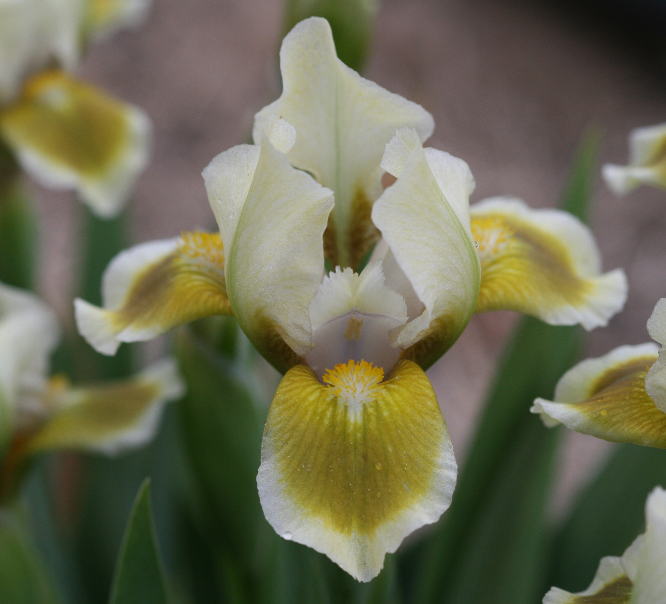
Fairy Firefly
Gecko Echo
(Aitken, 2015)
(Kasperek, 2007)

Slide 7
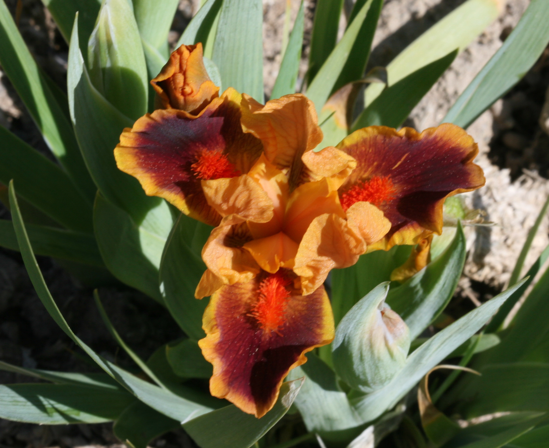
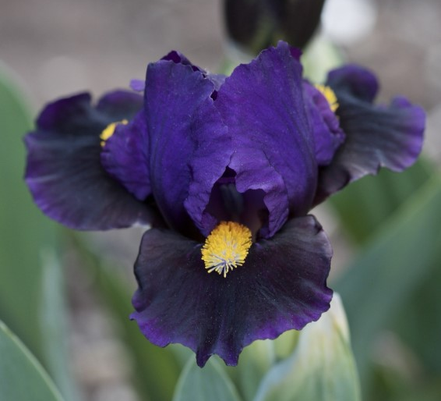
Icon
Kay
(Keppel, 2008)
(Johnson, 2017)

Slide 8
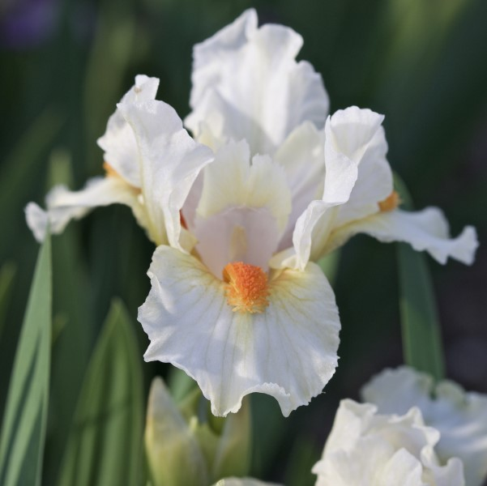
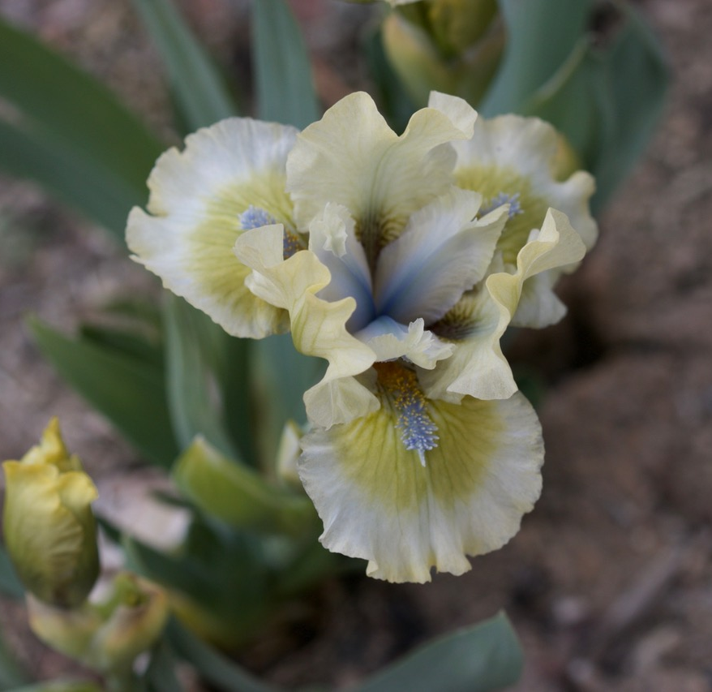
Pearly Whites
Ribbit
(Black, 2014)
(Johnson, 2020)

Slide 9
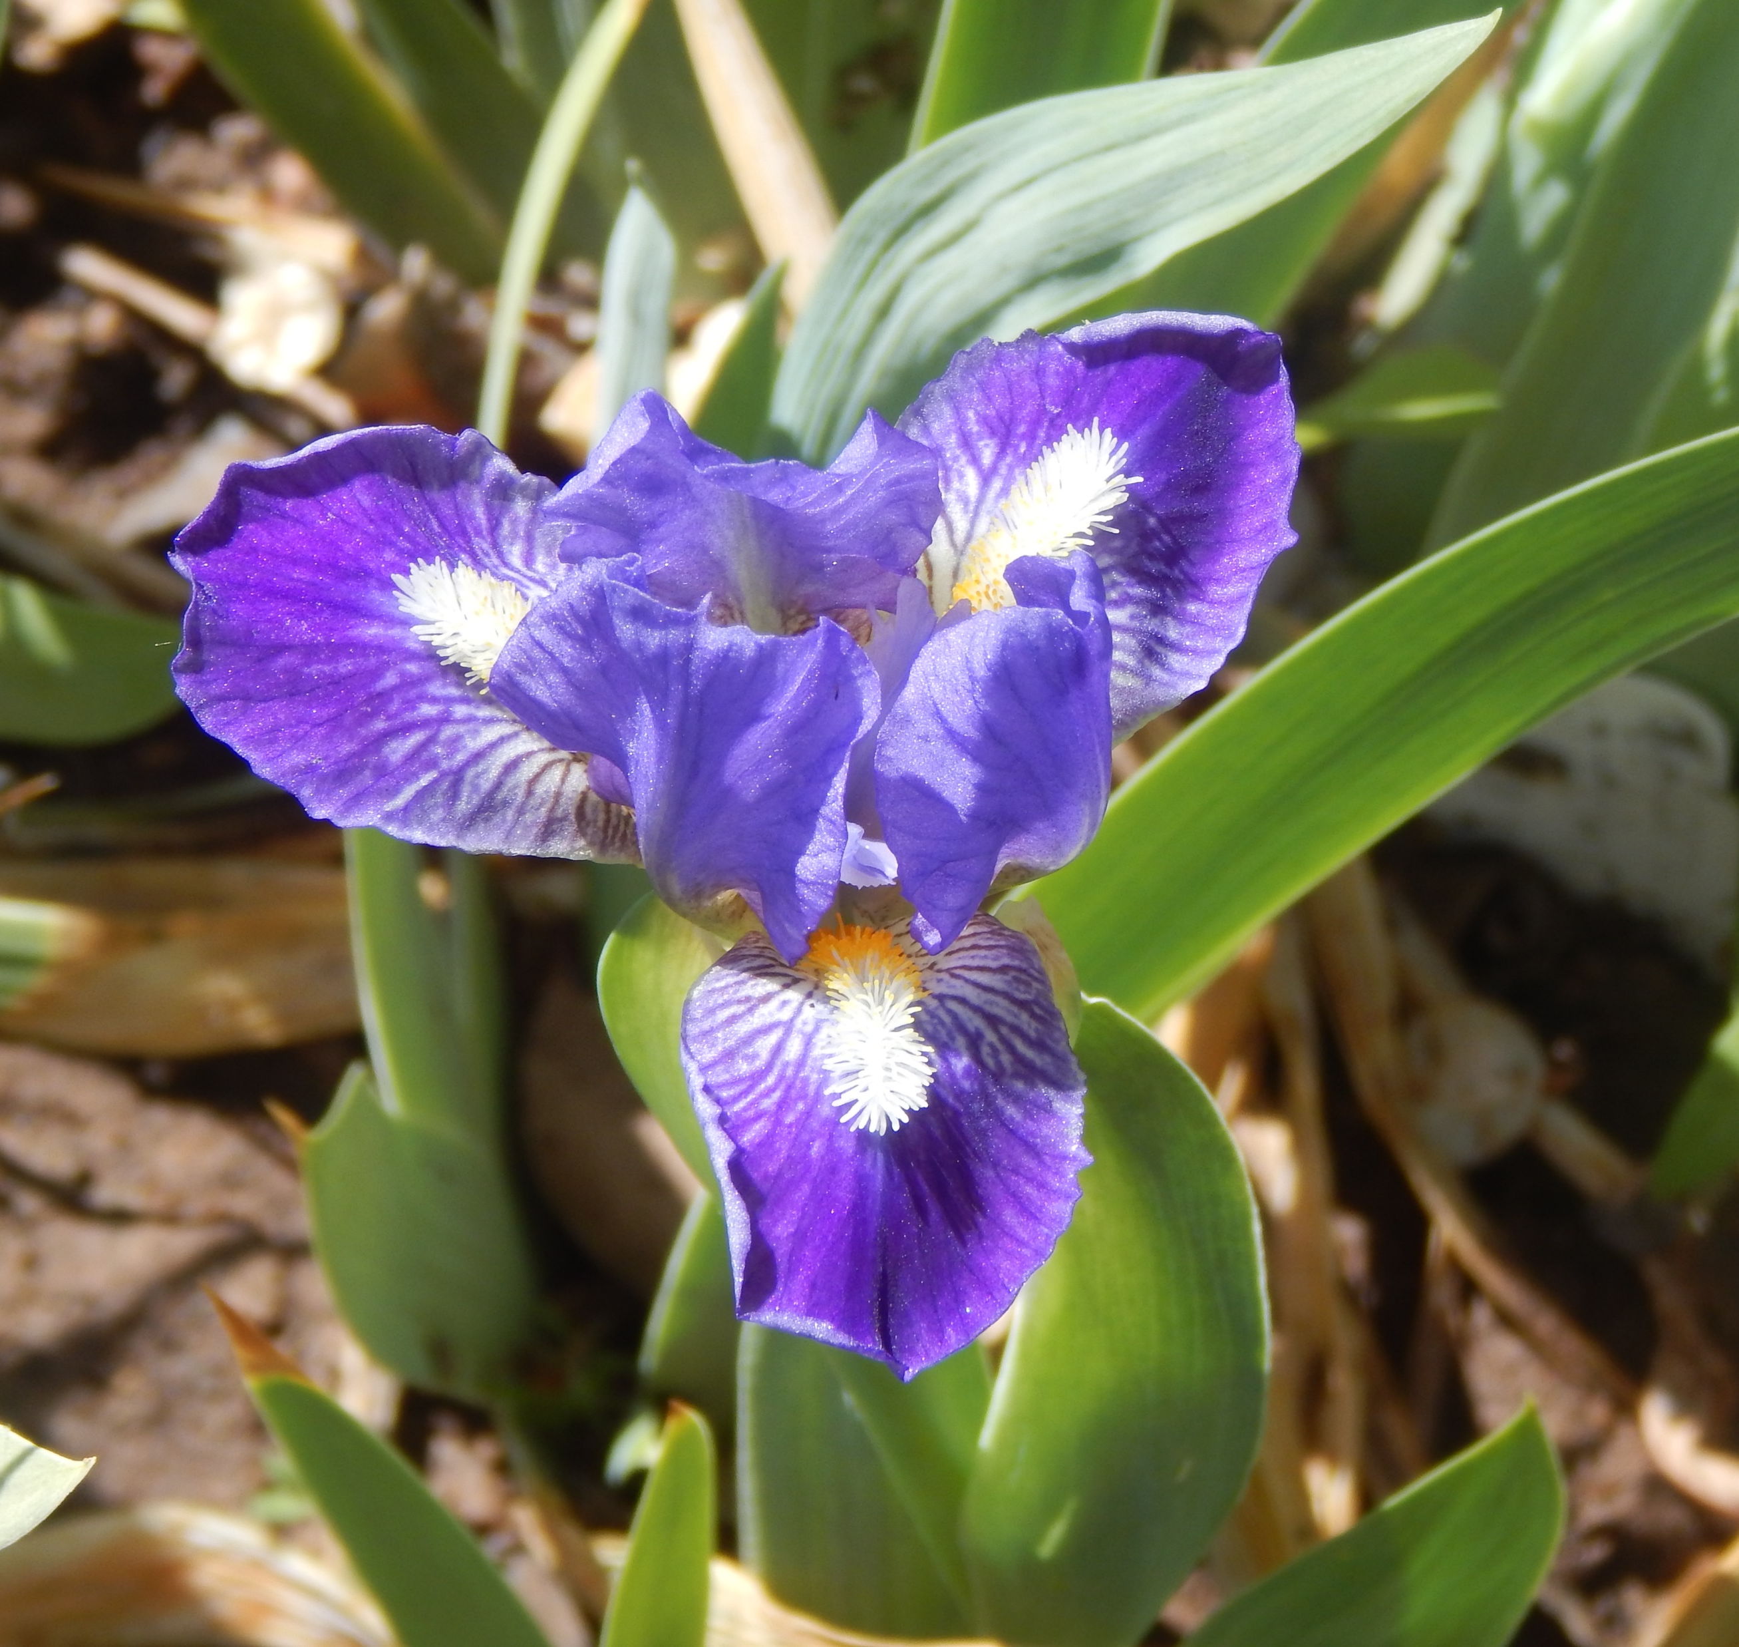
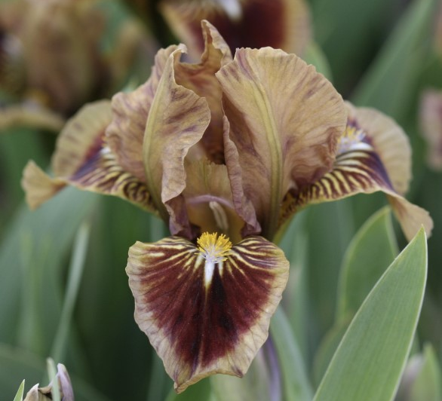
Short Nip
Spot of Tea
(Walker, 2021)
(Black, 1989)

Slide 10
Additional Type I MDBs
Iris lutescens (most DB irises prior to the 1950s): similar in size and proportion to modern type I MDBs or small SDBs, but limited color range
Tetraploid MTB x I. pumila (Ben Hager): since SDBs come from
TB X I. pumila, using MTBs instead of TBs should result in consistently smaller (MDB size) plants
I. reichenbachii X I. pumila: smallest of all!

Slide 11
Type II
Typical Parentage: SDB X I. pumila
  (SDB parent may also be a type I MDB)
Most popular type of MDB through the 1960s and 1970s
No plicatas, pinks, or oranges
Require some winter cold ( ~ zone 7)
Chromosome configuration PPPT (3/4 pumila, 1/4 TB; 36 chromosomes)
Limited fertility
Early bloom
Most 5 to 6 inches in height, seldom grow out of class

Slide 12
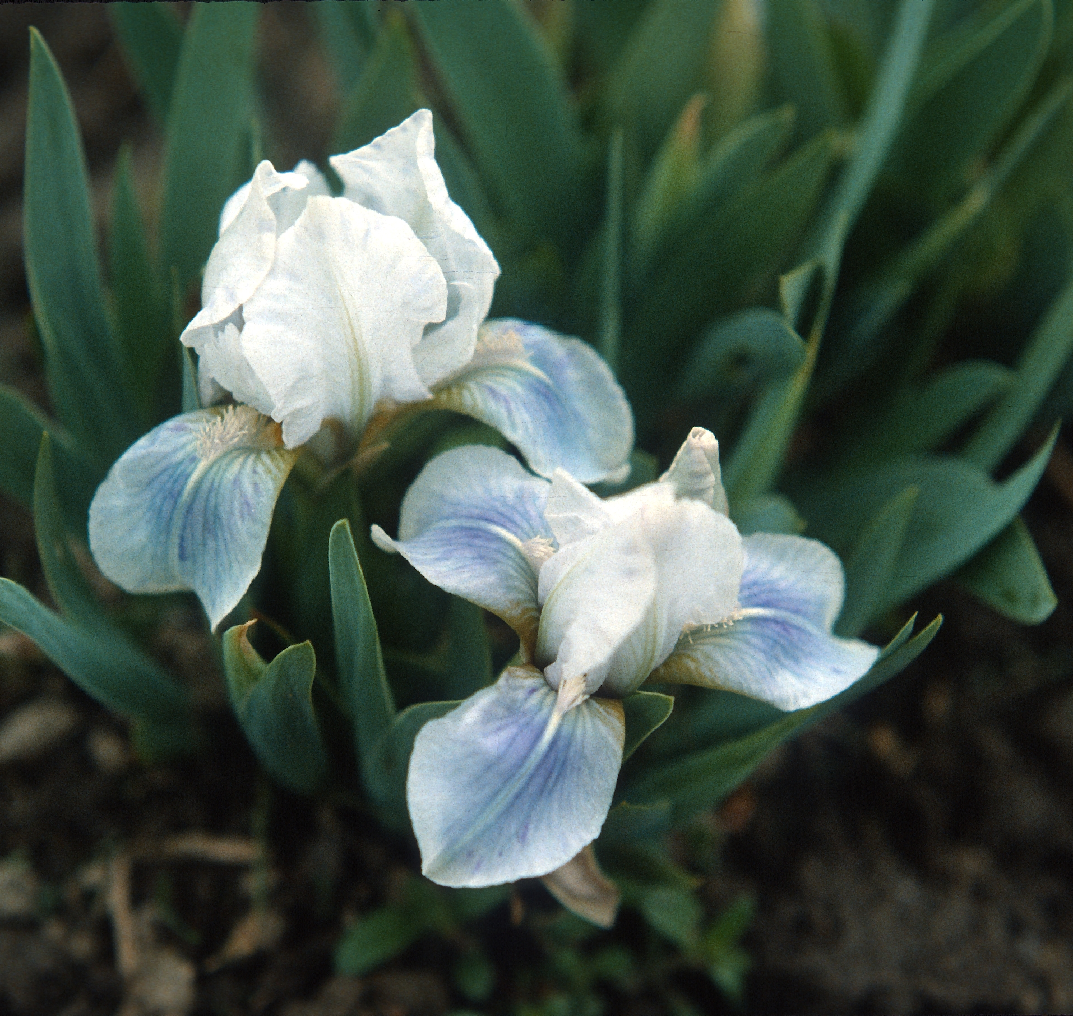
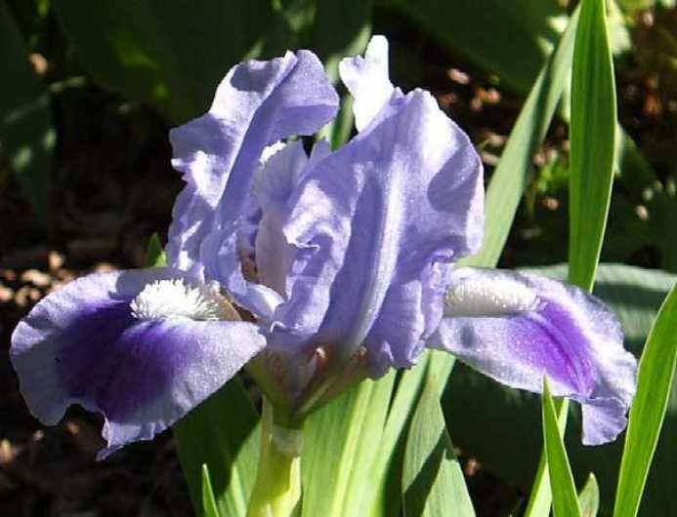
Alpine Lake
April Ballet
(Willott, 1981)
(Palmer, 1973)

Slide 13
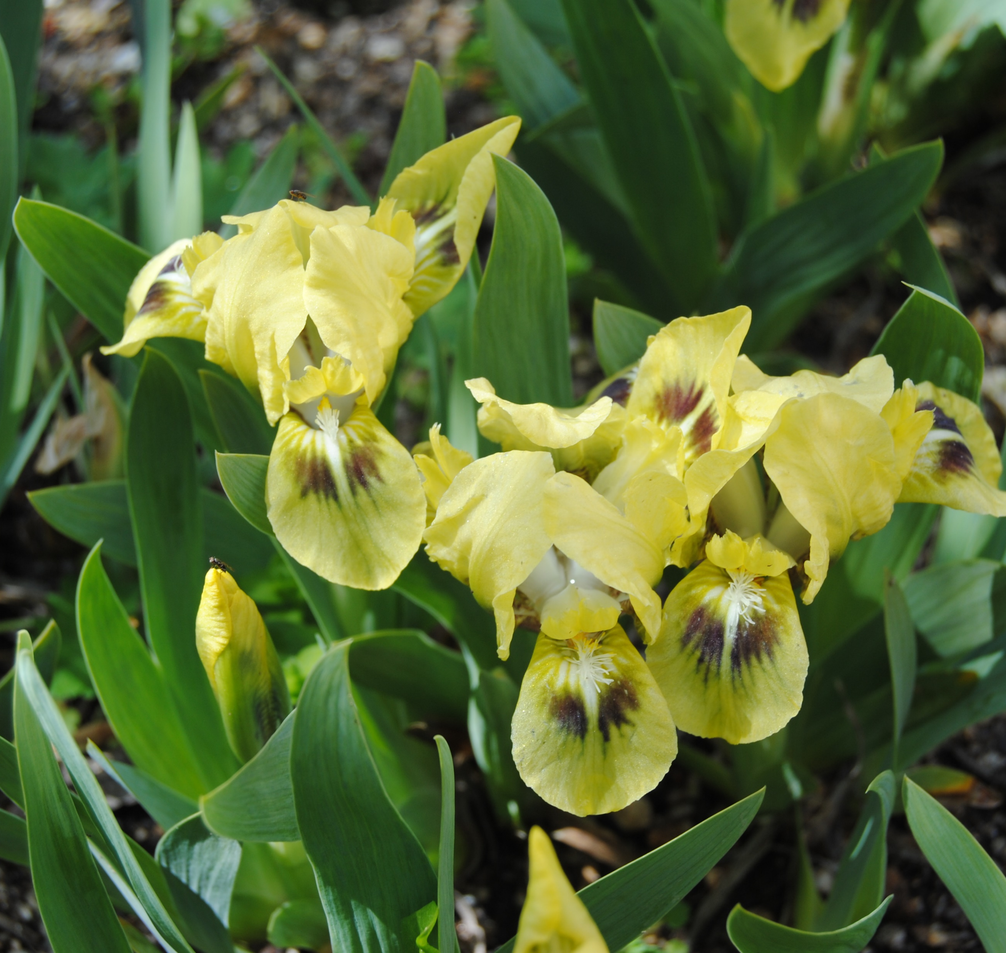
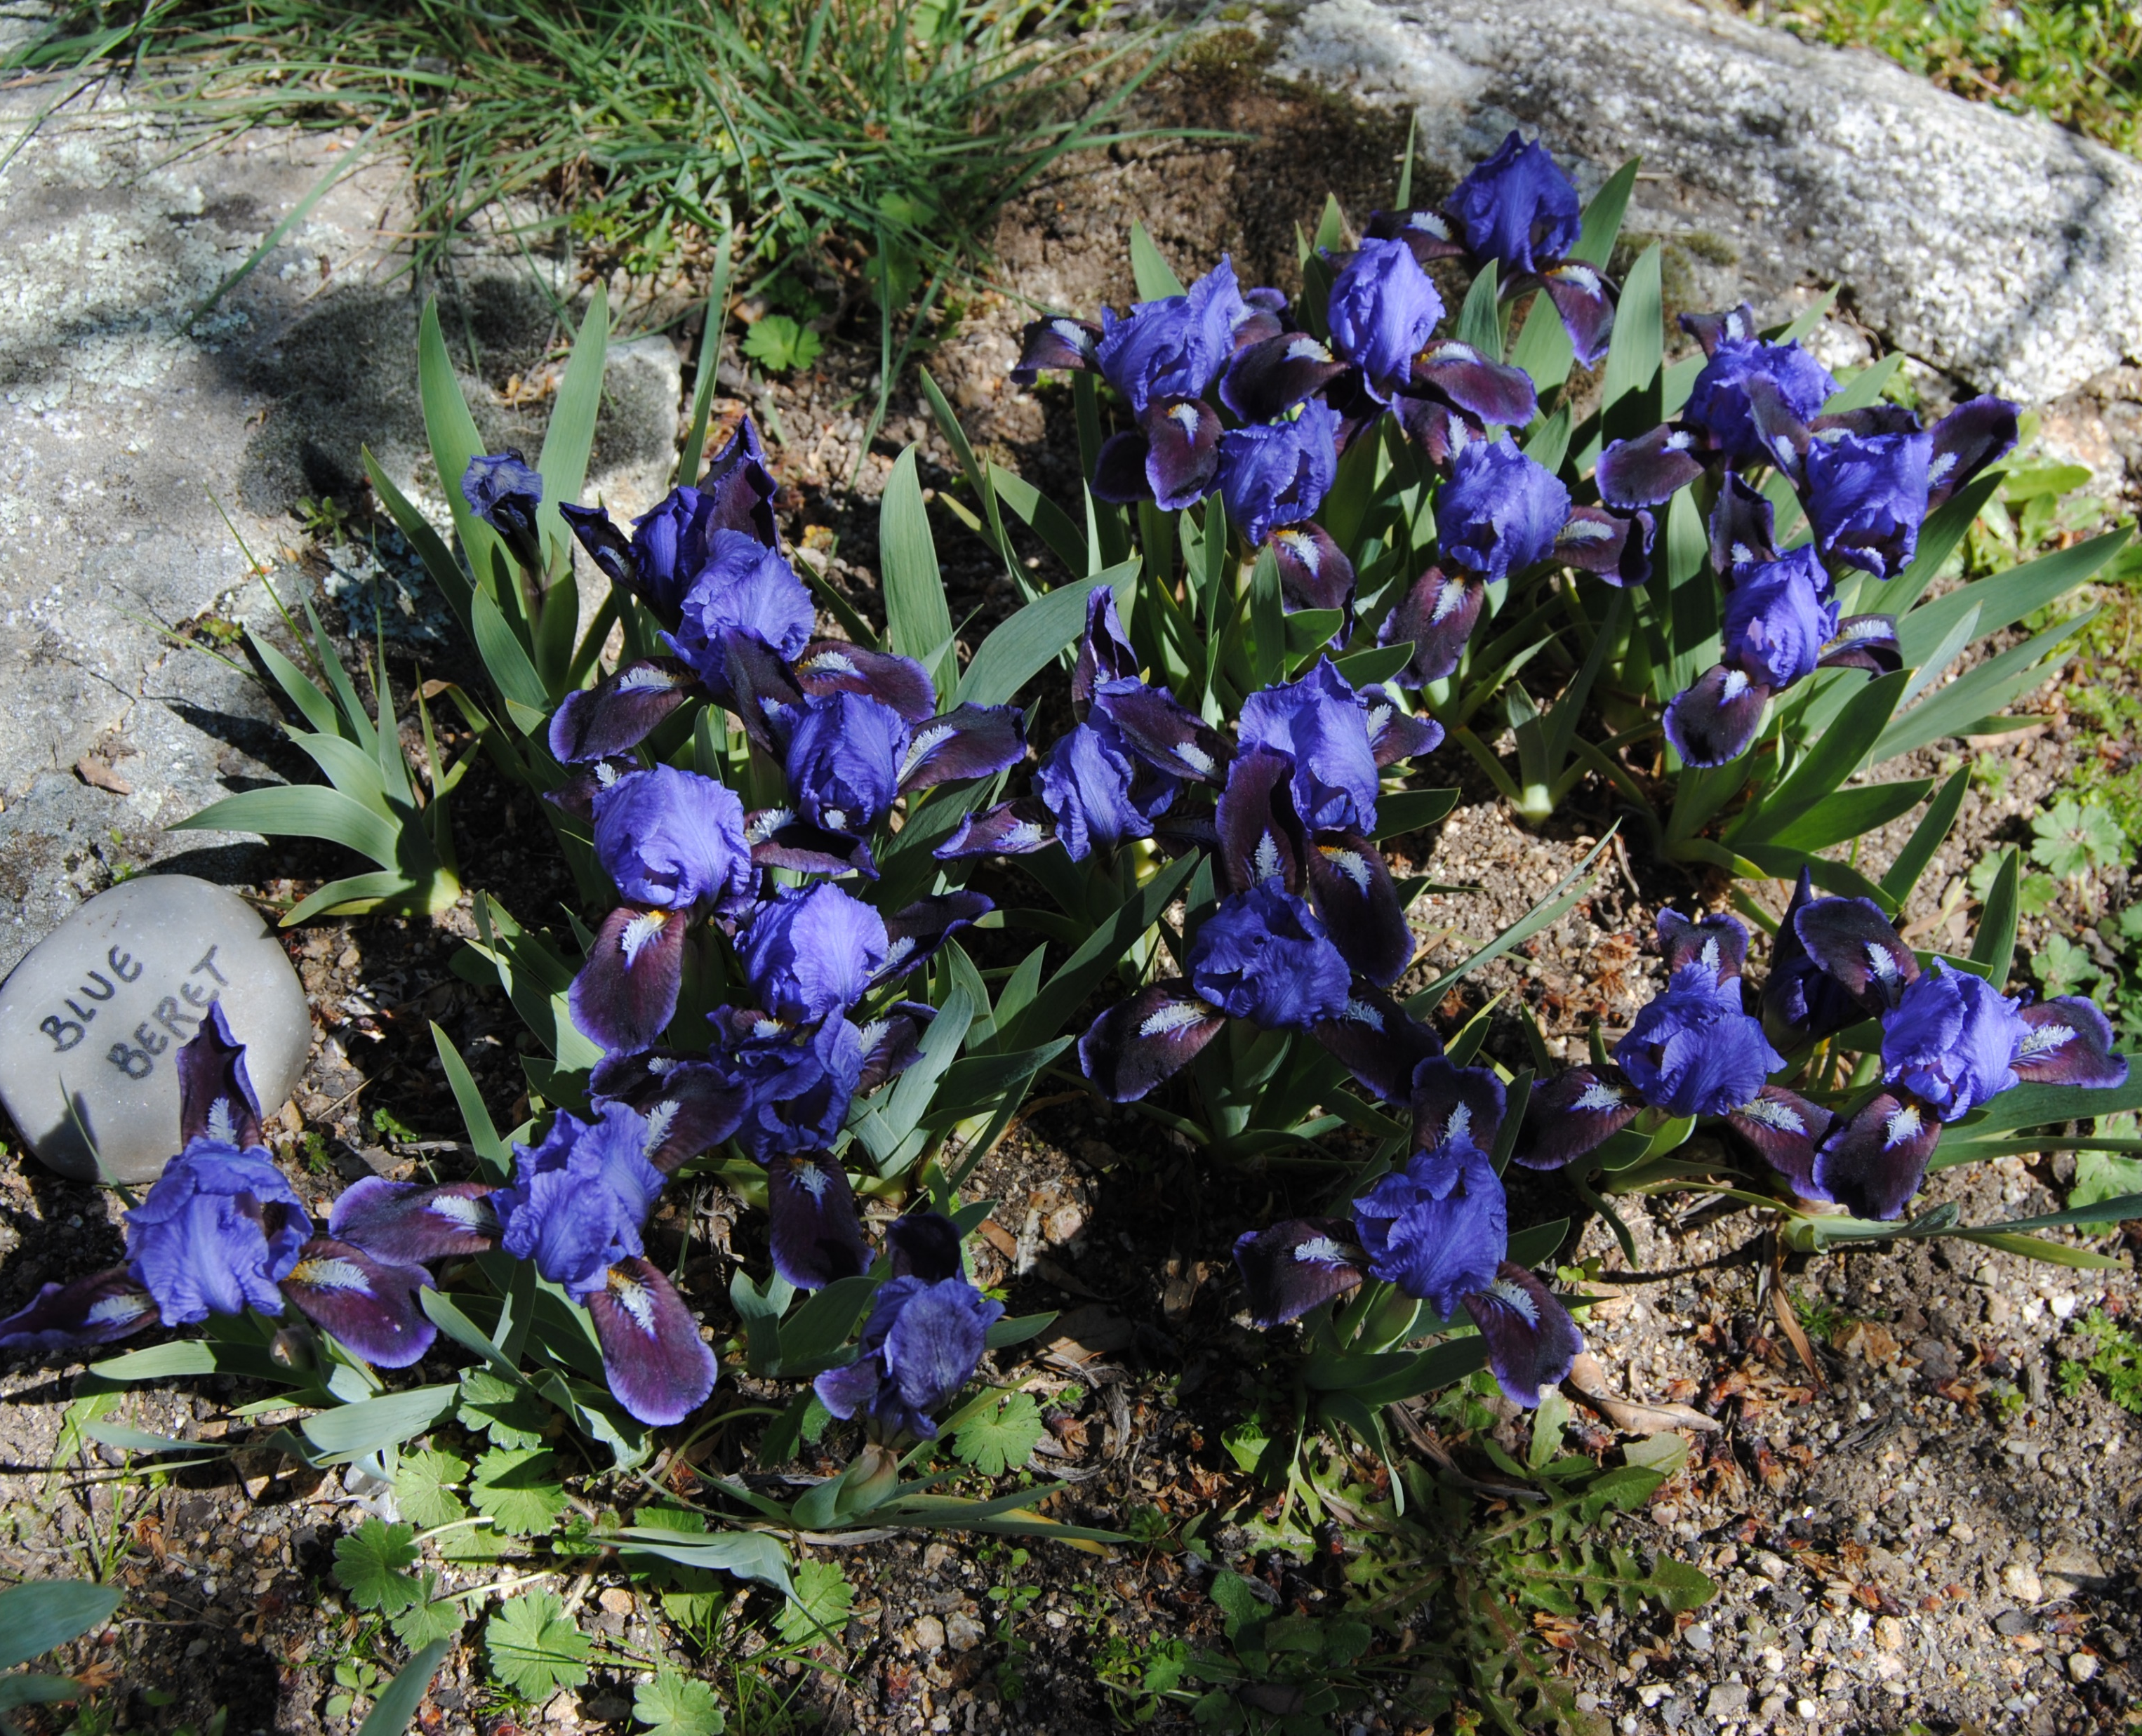
Bee Wings
Blue Beret
(Brown, 1960)
(Roberts, 1967)

Slide 14
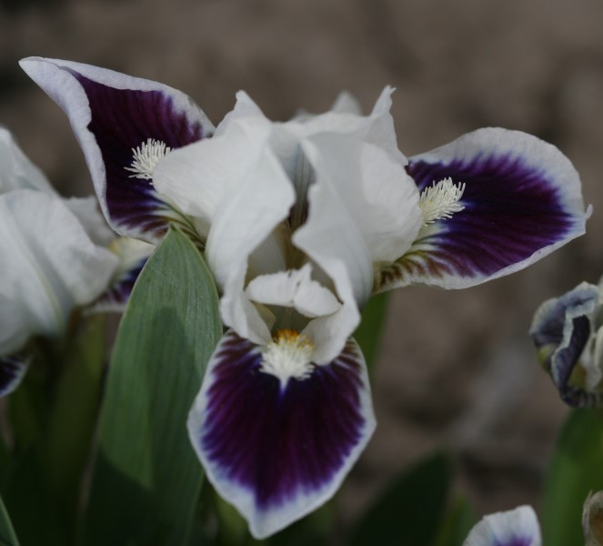
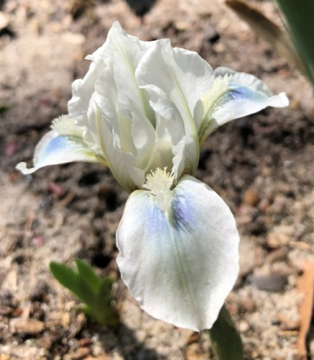
Crown of Snow
Flirty Eyes
(Willott, 2001)
(Roberts, 1973)

Slide 15
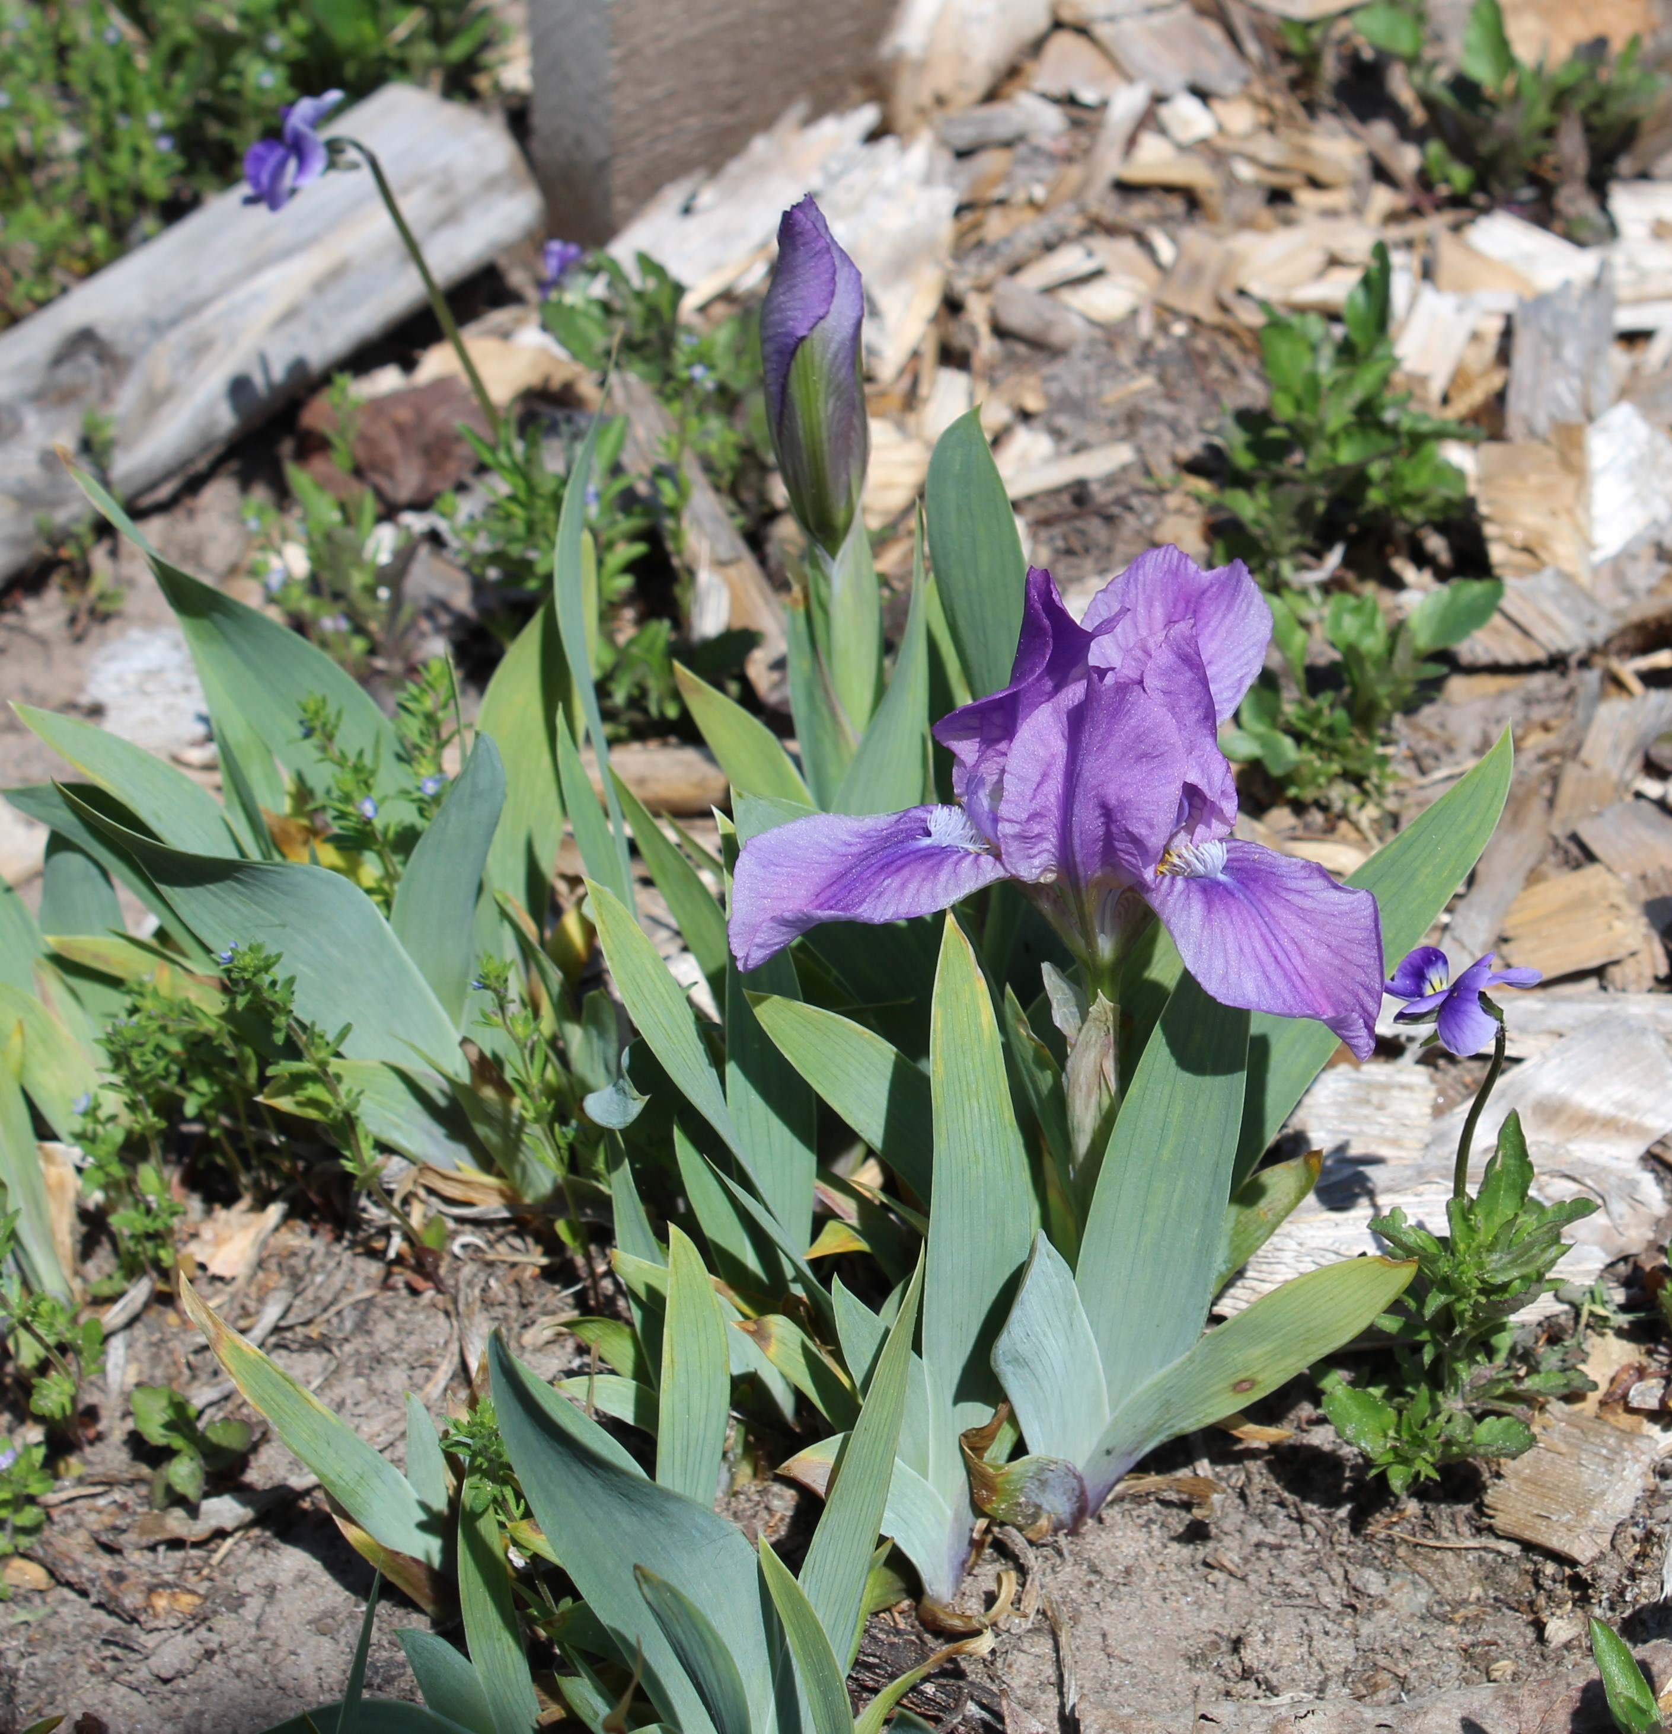
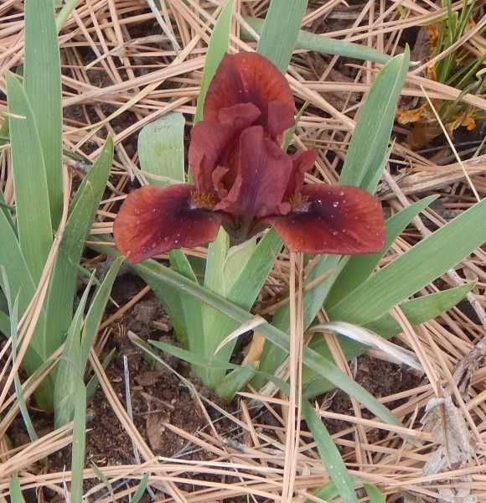
Orchid Flair
Small Token
(Mahood, 1961)
(Miller, 2014)

Slide 16
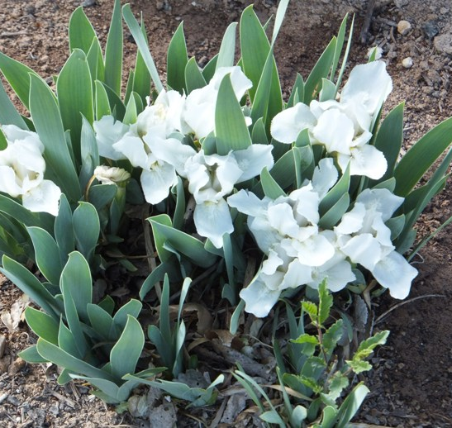
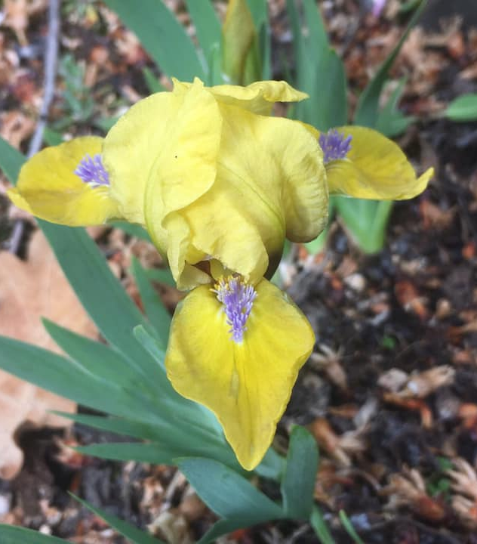
Snowy River
Zipper
(Willott, 1985)
(Sindt, 1979)

Slide 17
Type III
Typical Parentage: I. pumila X I. pumila
Relatively few in number
White, yellow, purple, and blue, usually with contrasting spot
Require winter cold ( ~ zone 6)
Chromosome configuration PPPP (pure pumila; 32 chromosomes)
Fully fertile
Very early bloom, before any other bearded irises
Most 3 to 5 inches in height, never grow out of class

Slide 18
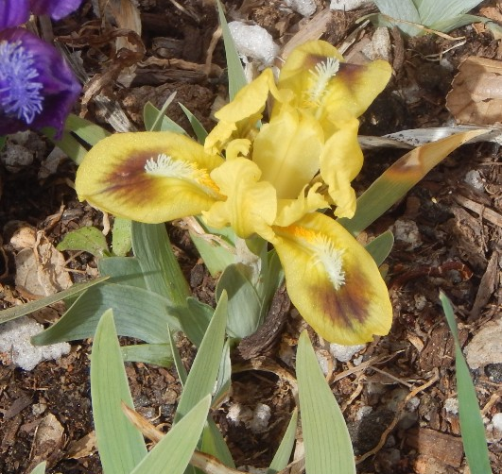
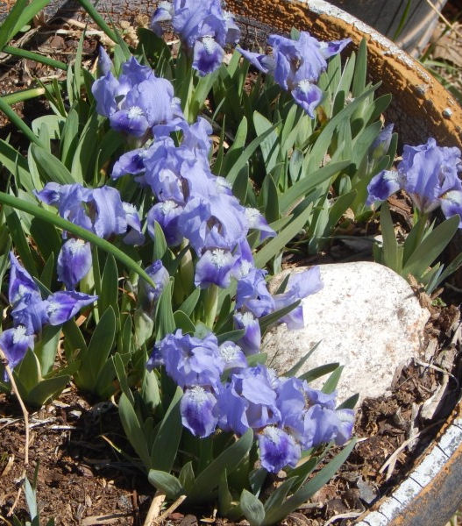
Bee Early
Hobbit
(Miller, 1989)
(Miller, 2004)

Slide 19
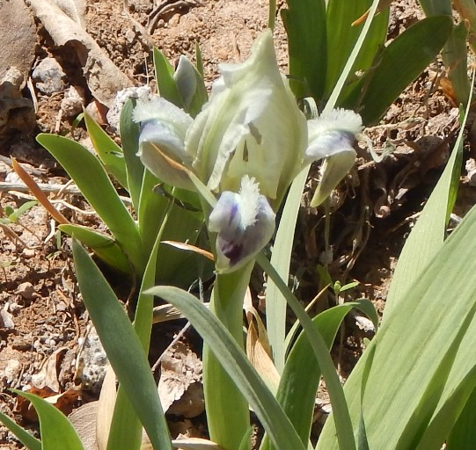
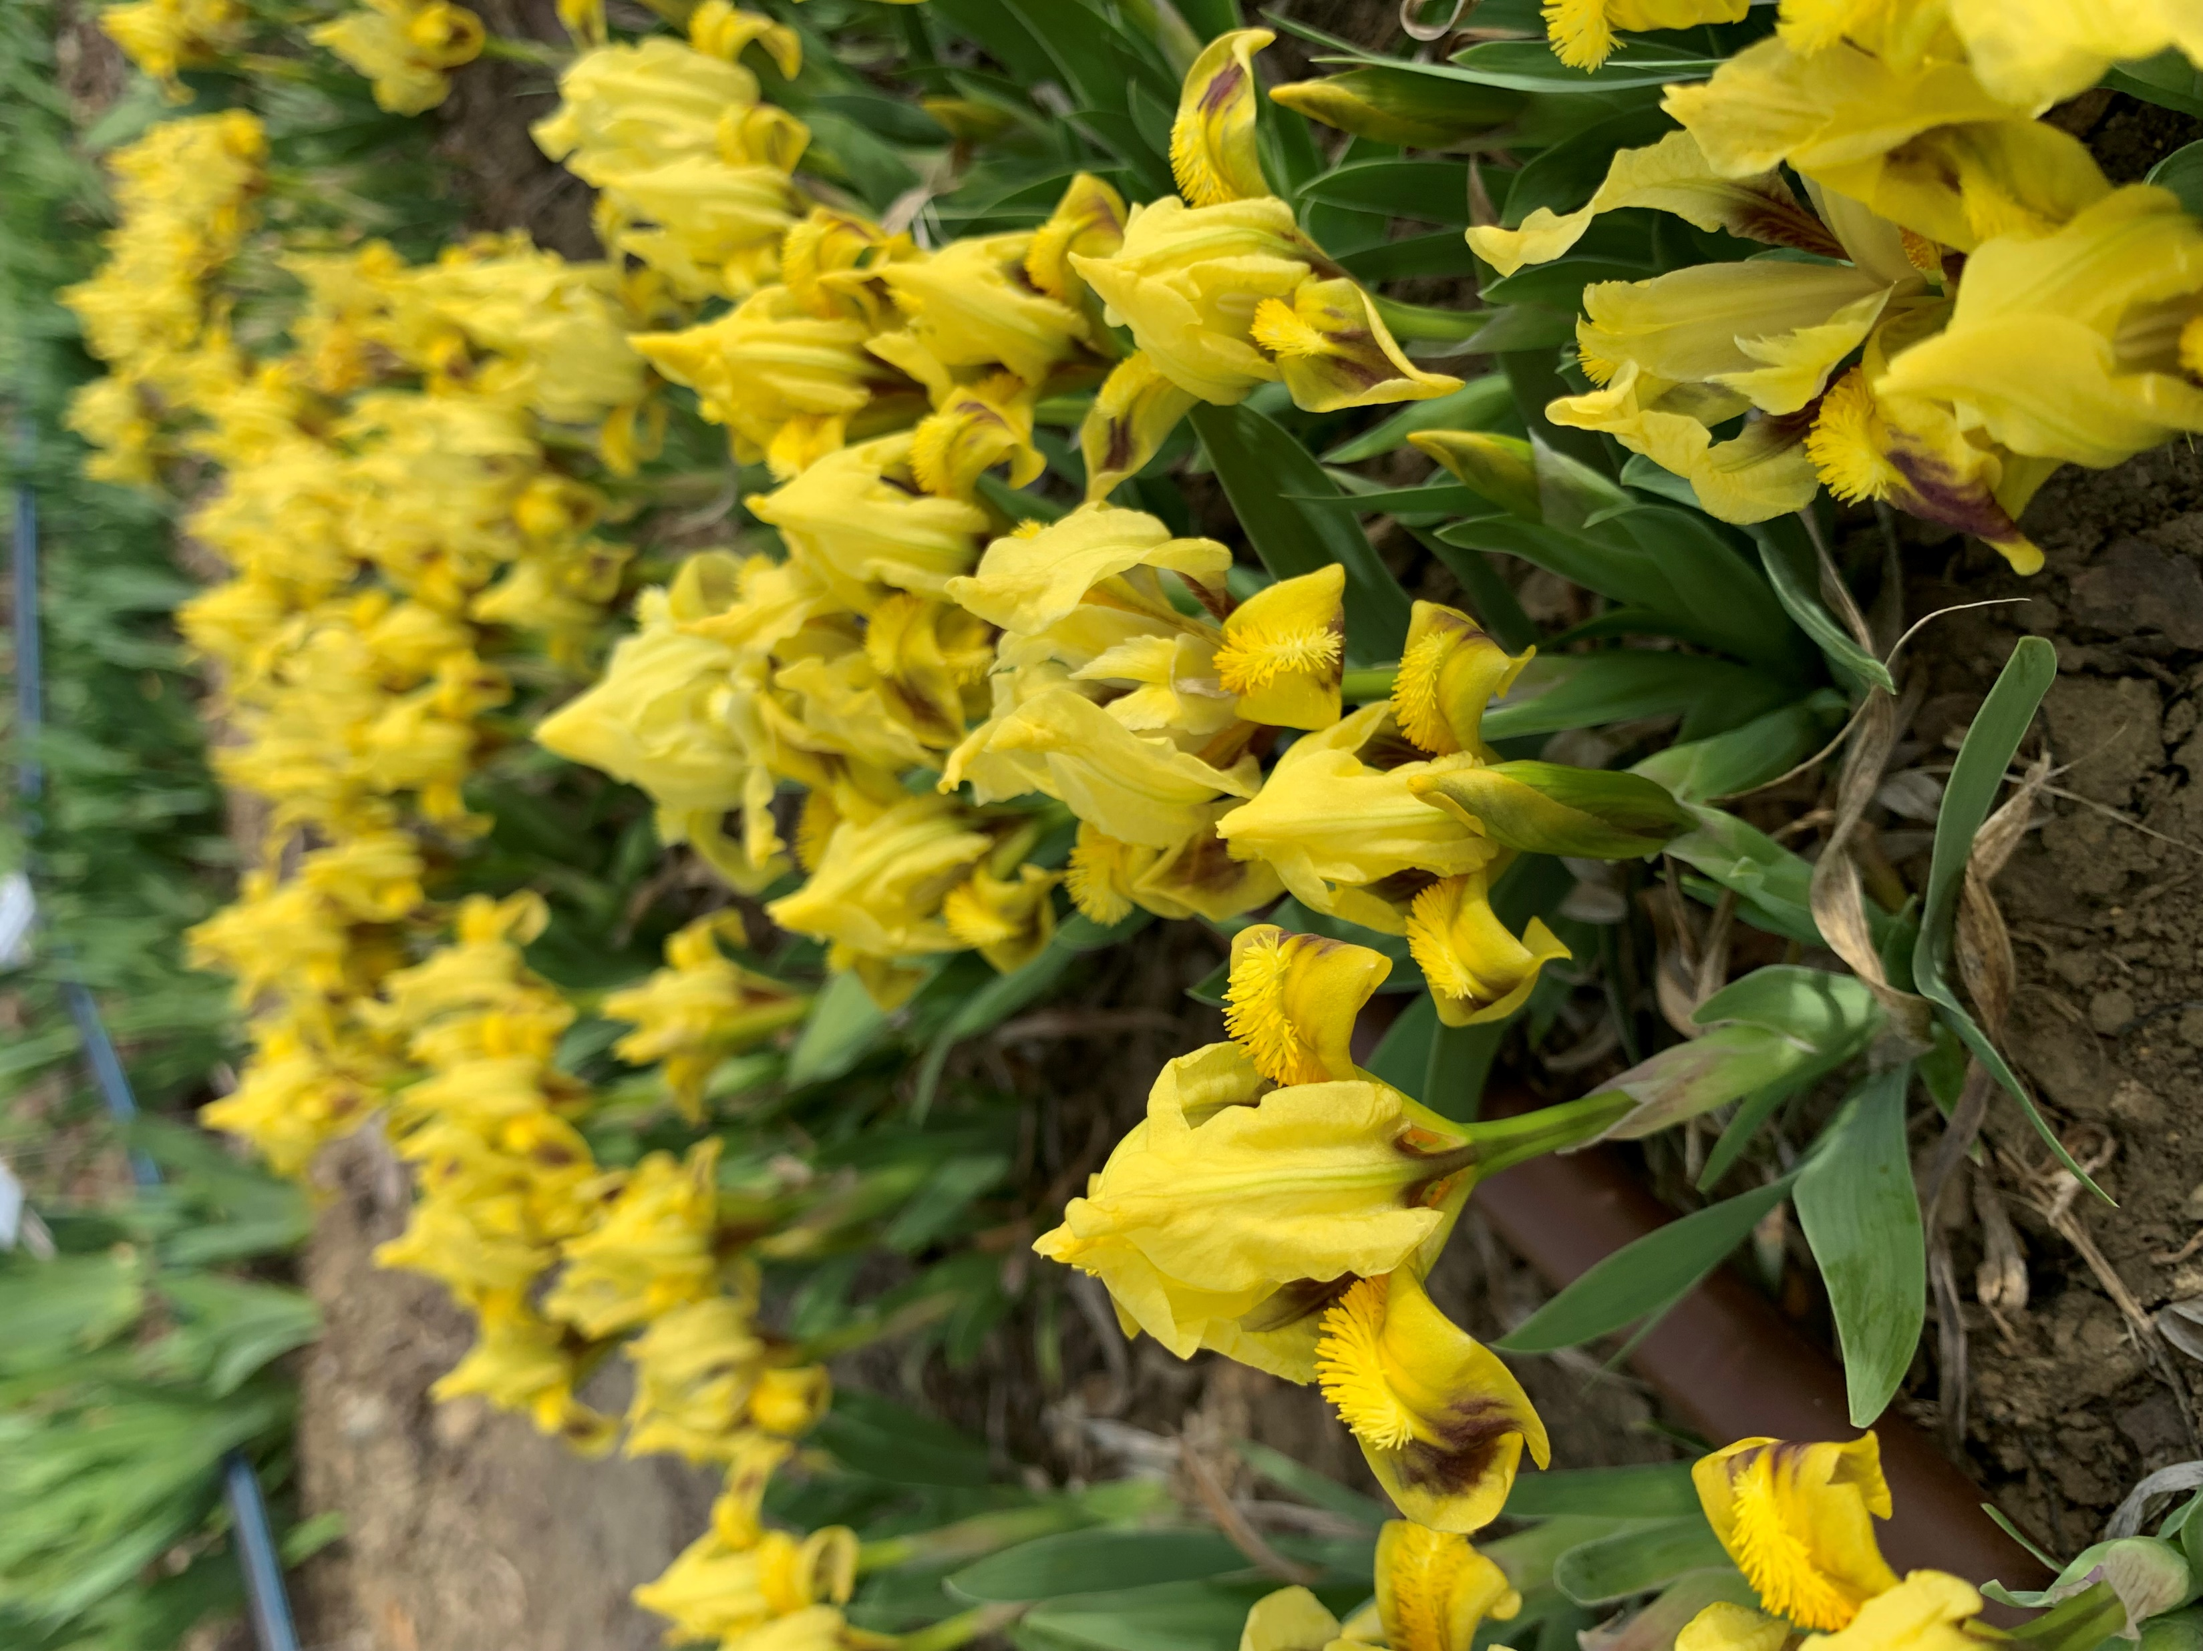
Keystone Oracle
Lesser Goldfinch
(Jesberger, 2011) SPEC
(Baumunk, 2003) SPEC

Slide 20
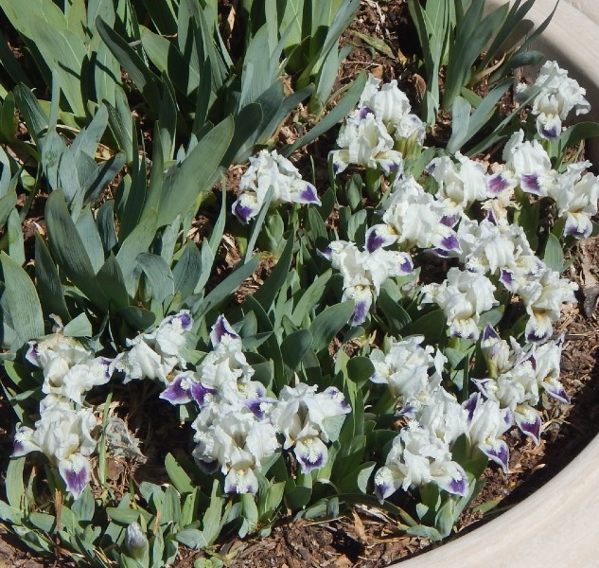
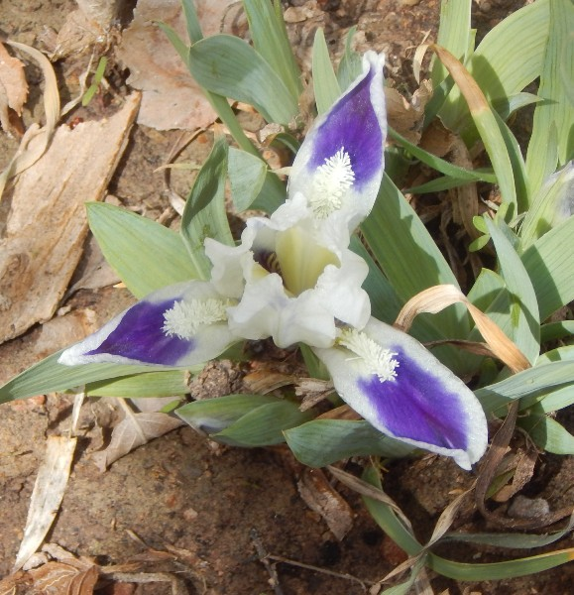
Little Drummer Boy
Peepers
(Willott, 1997)
(Miller, 1991)

Slide 21
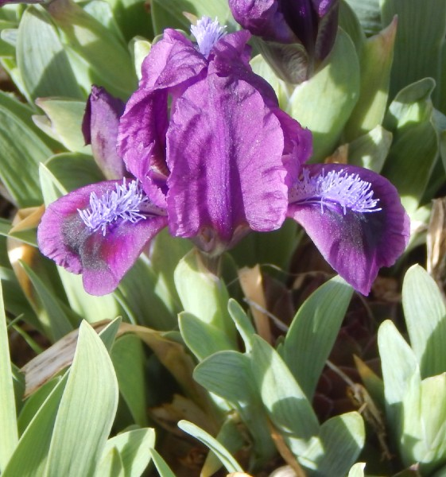
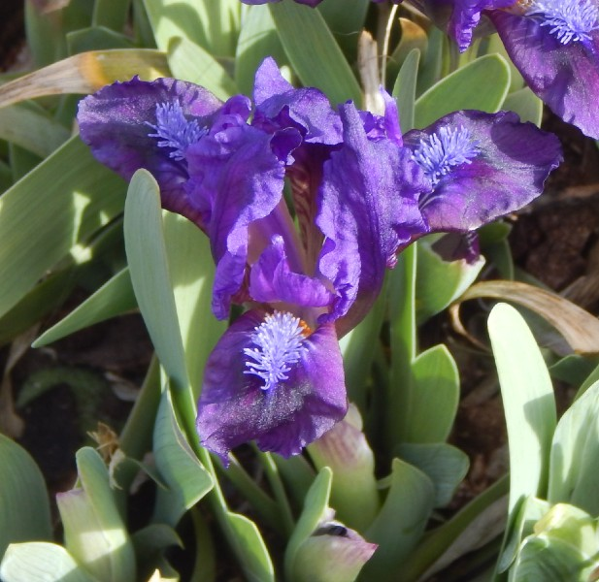
Royal Wonder
Wild Whispers
(Coleman, 2013)
(Coleman, 2012) SPEC

Slide 22
Summary
 | Type I | Type II | Type III
Typical parentage | SDB X SDB | SDB X I. pumila | I. pumila X I. pumila
Winter cold | Zones 5-8 | Zones 4-7 | Zones 3-6
Height | 6-8” | 5-6” | 3-5”
Season | Early to mid | Early | Very early
Colors | All TB colors | No orange or pink | White, yellow, blue, purple
Patterns | All TB patterns + spot | Selfs, bitones, spot | Spot
Buds | 2-3 | 2 | 1
Caparne-Welch winners | 46 | 15 | 4
Chromosome sets | PPTT (40) | PPPT (36) | PPPP (32)
Fertility | Fertile | Limited | Fertile

