Slide 1
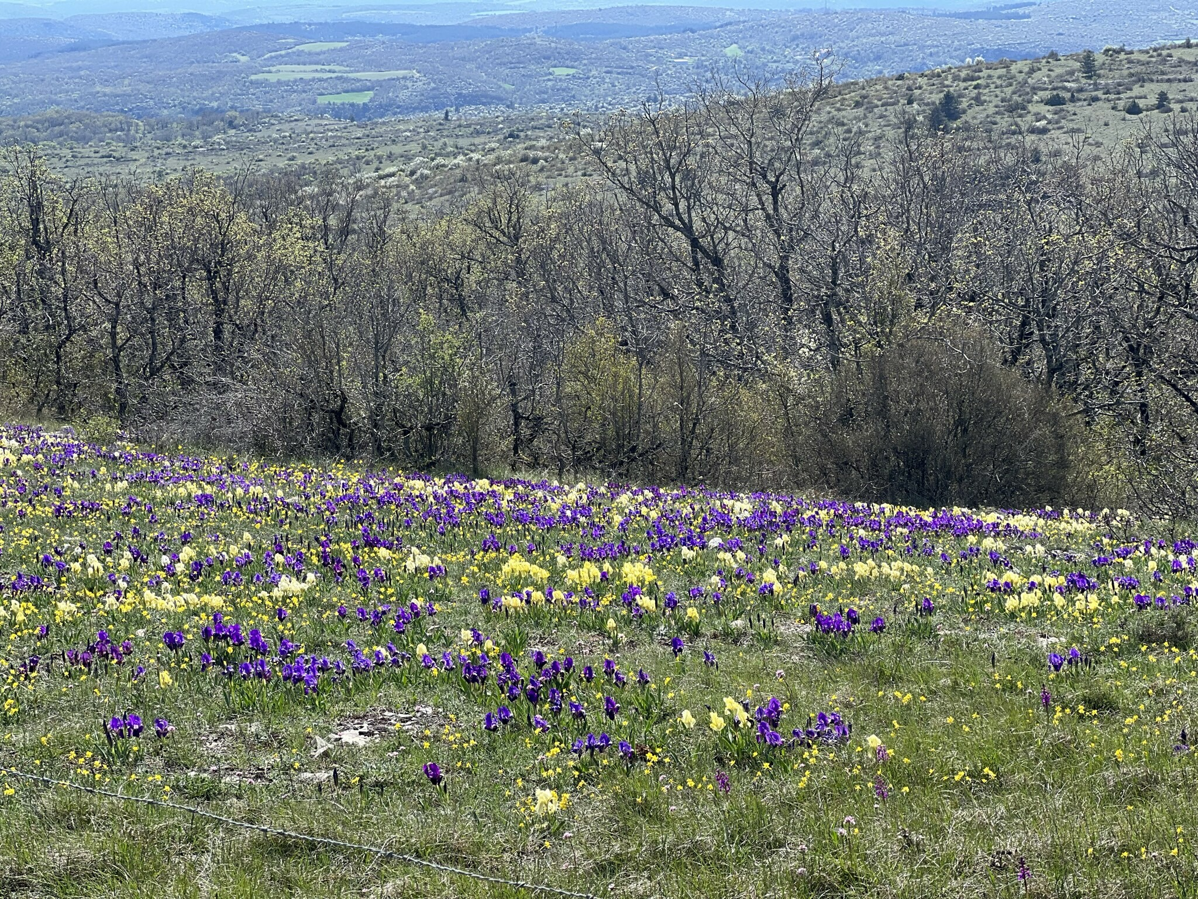
dwarf species irises
© Quentin Gaillard
via iNaturalist
Dwarf Iris Society
Membership Meeting
9/6/2025
Sean Zera

Slide 2
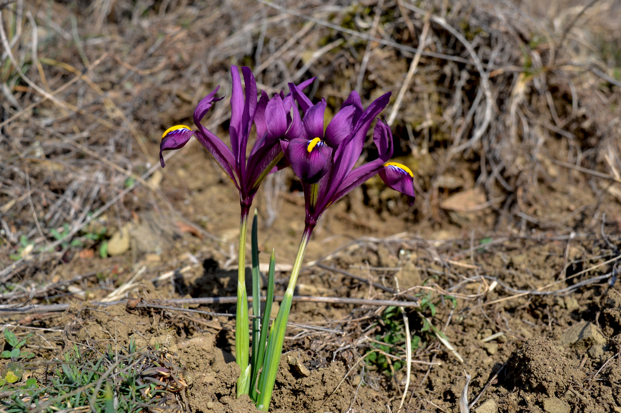
reticulatas
Iris reticulata
© crocusadamii
via iNaturalist

Slide 3
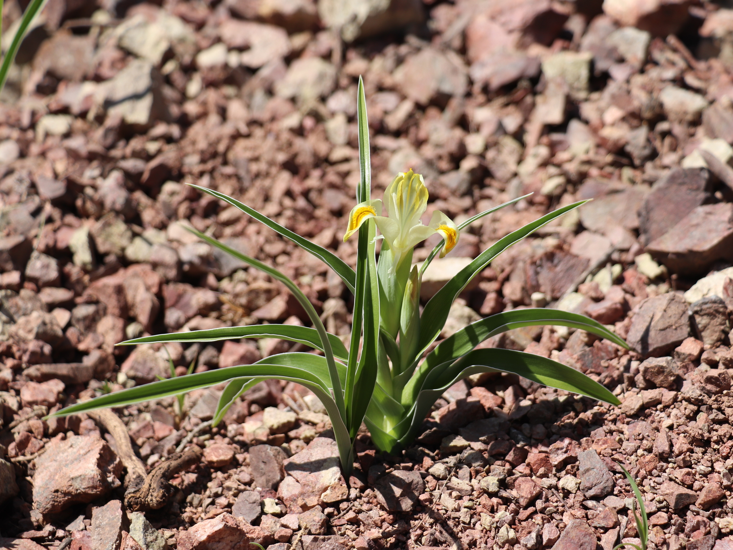
junos
Iris orchioides
© Наталья Бешко
via iNaturalist

Slide 4
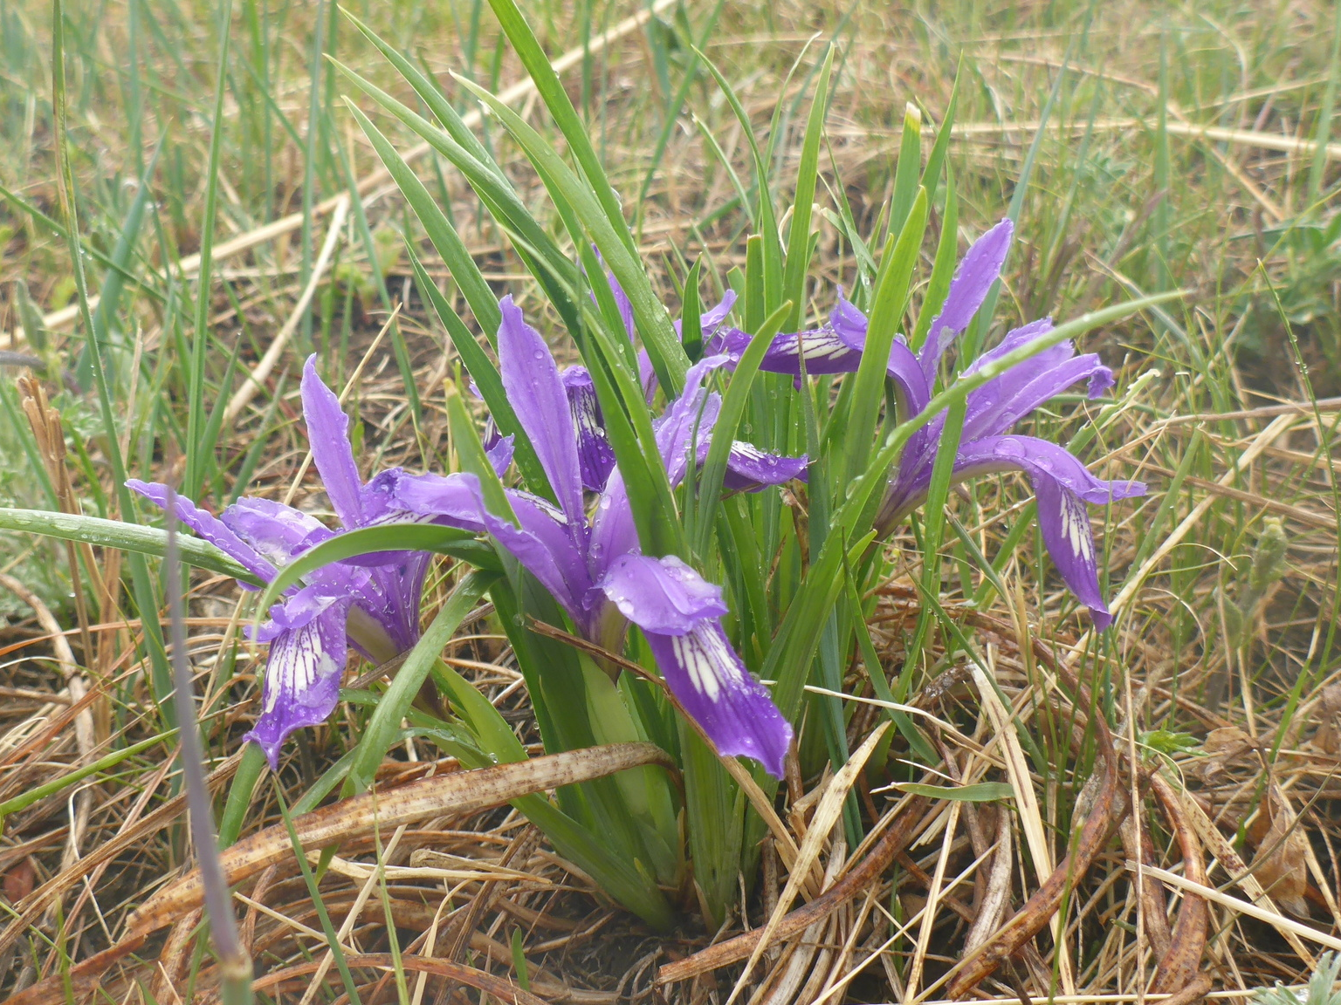
Iris ruthenica
© anatoliipomortsev
via iNaturalist

Slide 5
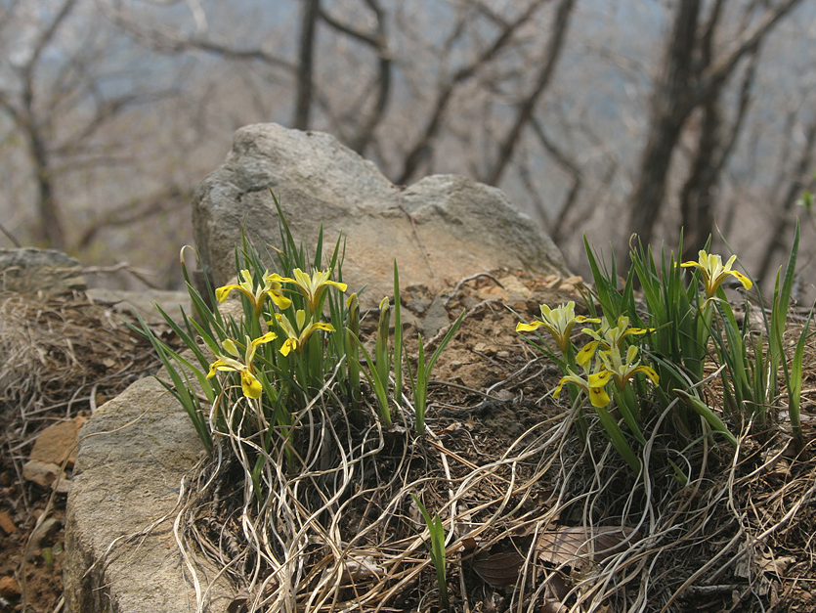
Iris minutoaurea
Chinenses
© Lee, seong-won
via iNaturalist

Slide 6
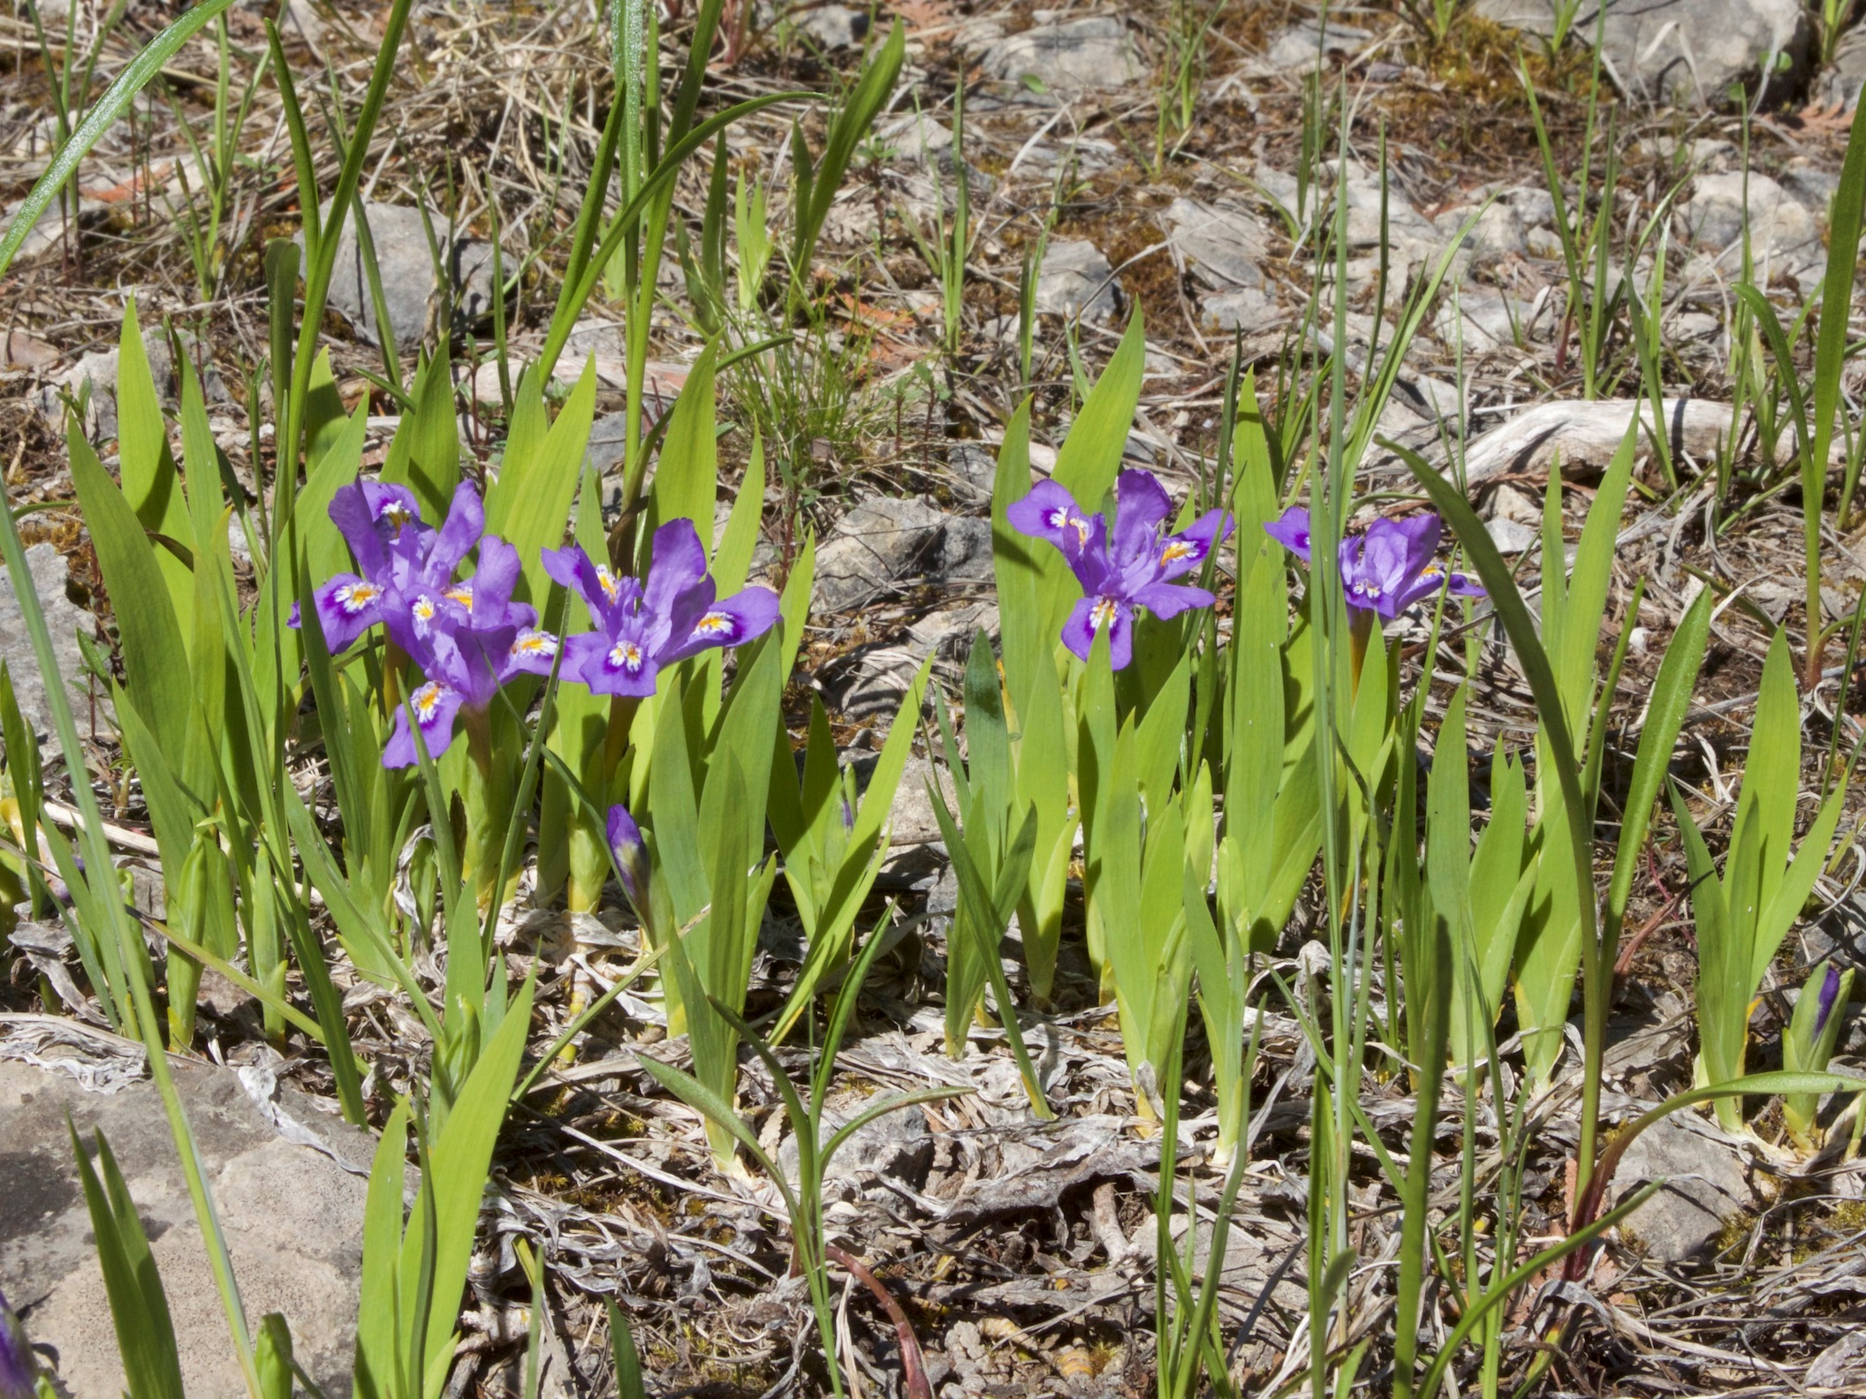
dwarf crested
Iris lacustris
© Sean Zera

Slide 7
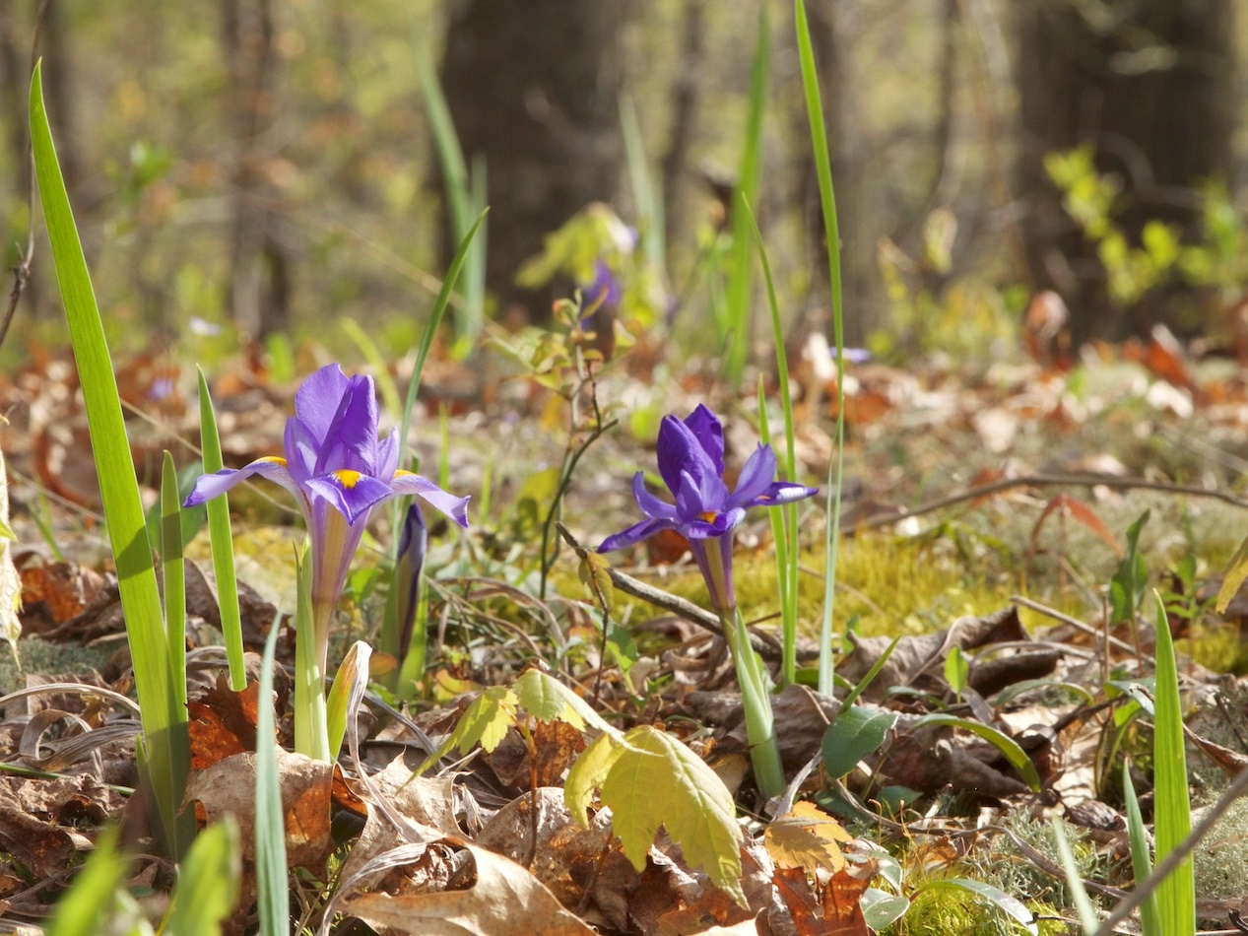
Iris verna
© Sean Zera

Slide 8
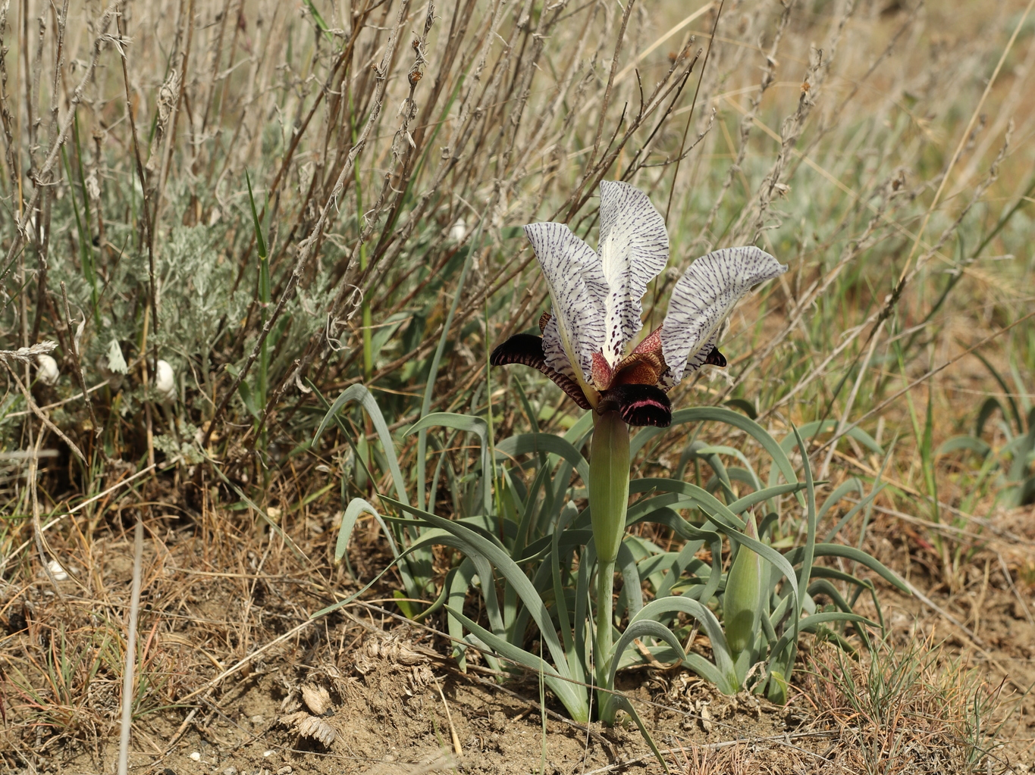
Oncocyclus
Iris paradoxa
© František Lamla
via iNaturalist

Slide 9
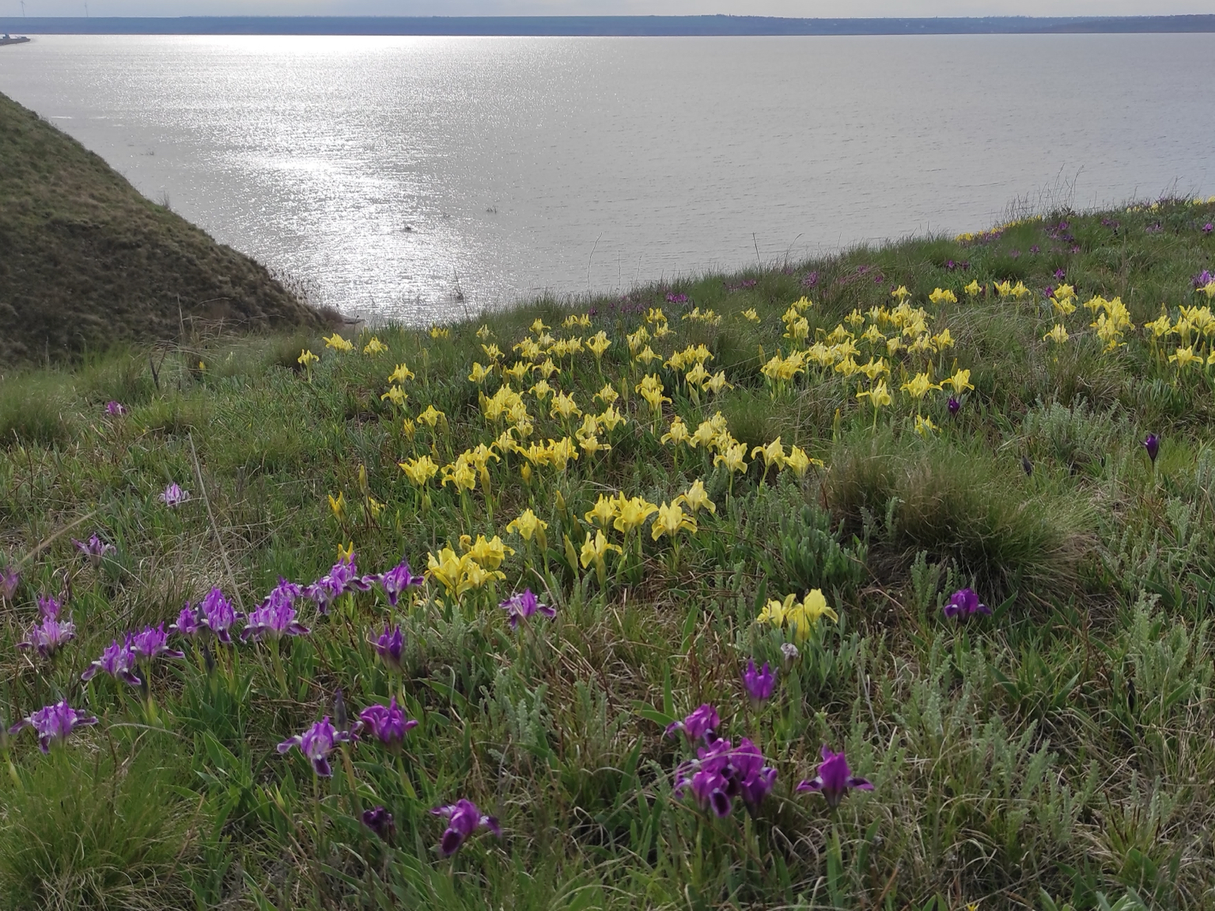
Iris pumila
© anastasiia_drapaliuk
via iNaturalist

Slide 10
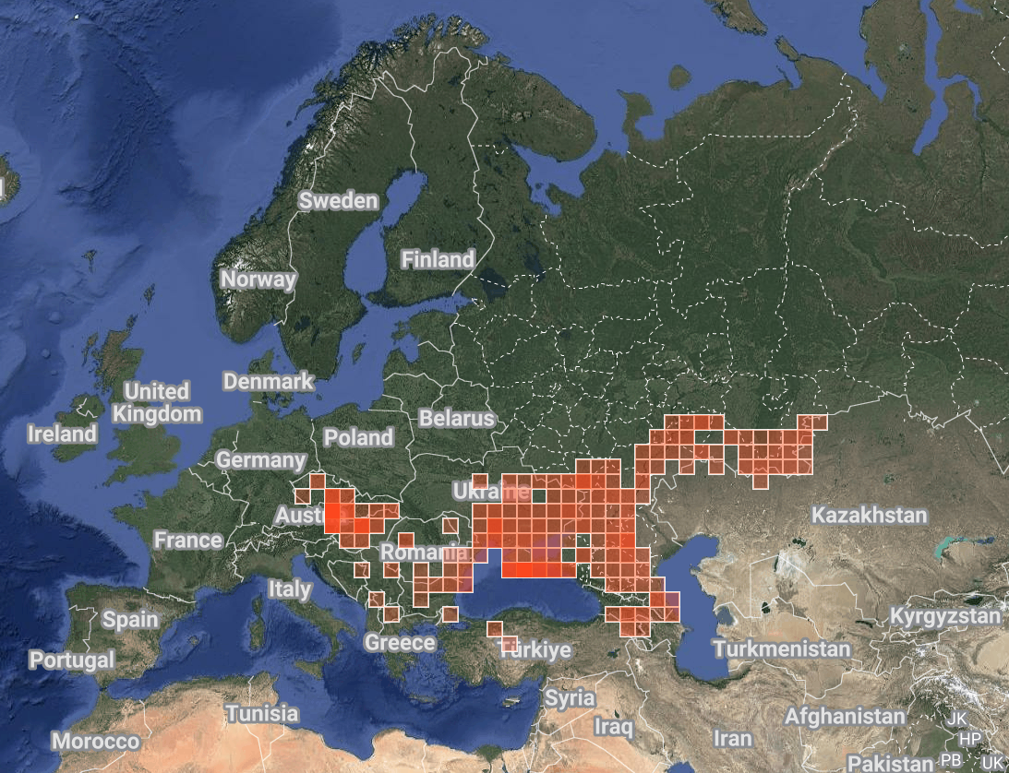
Iris pumila
© anastasiia_drapaliuk
via iNaturalist

Slide 11
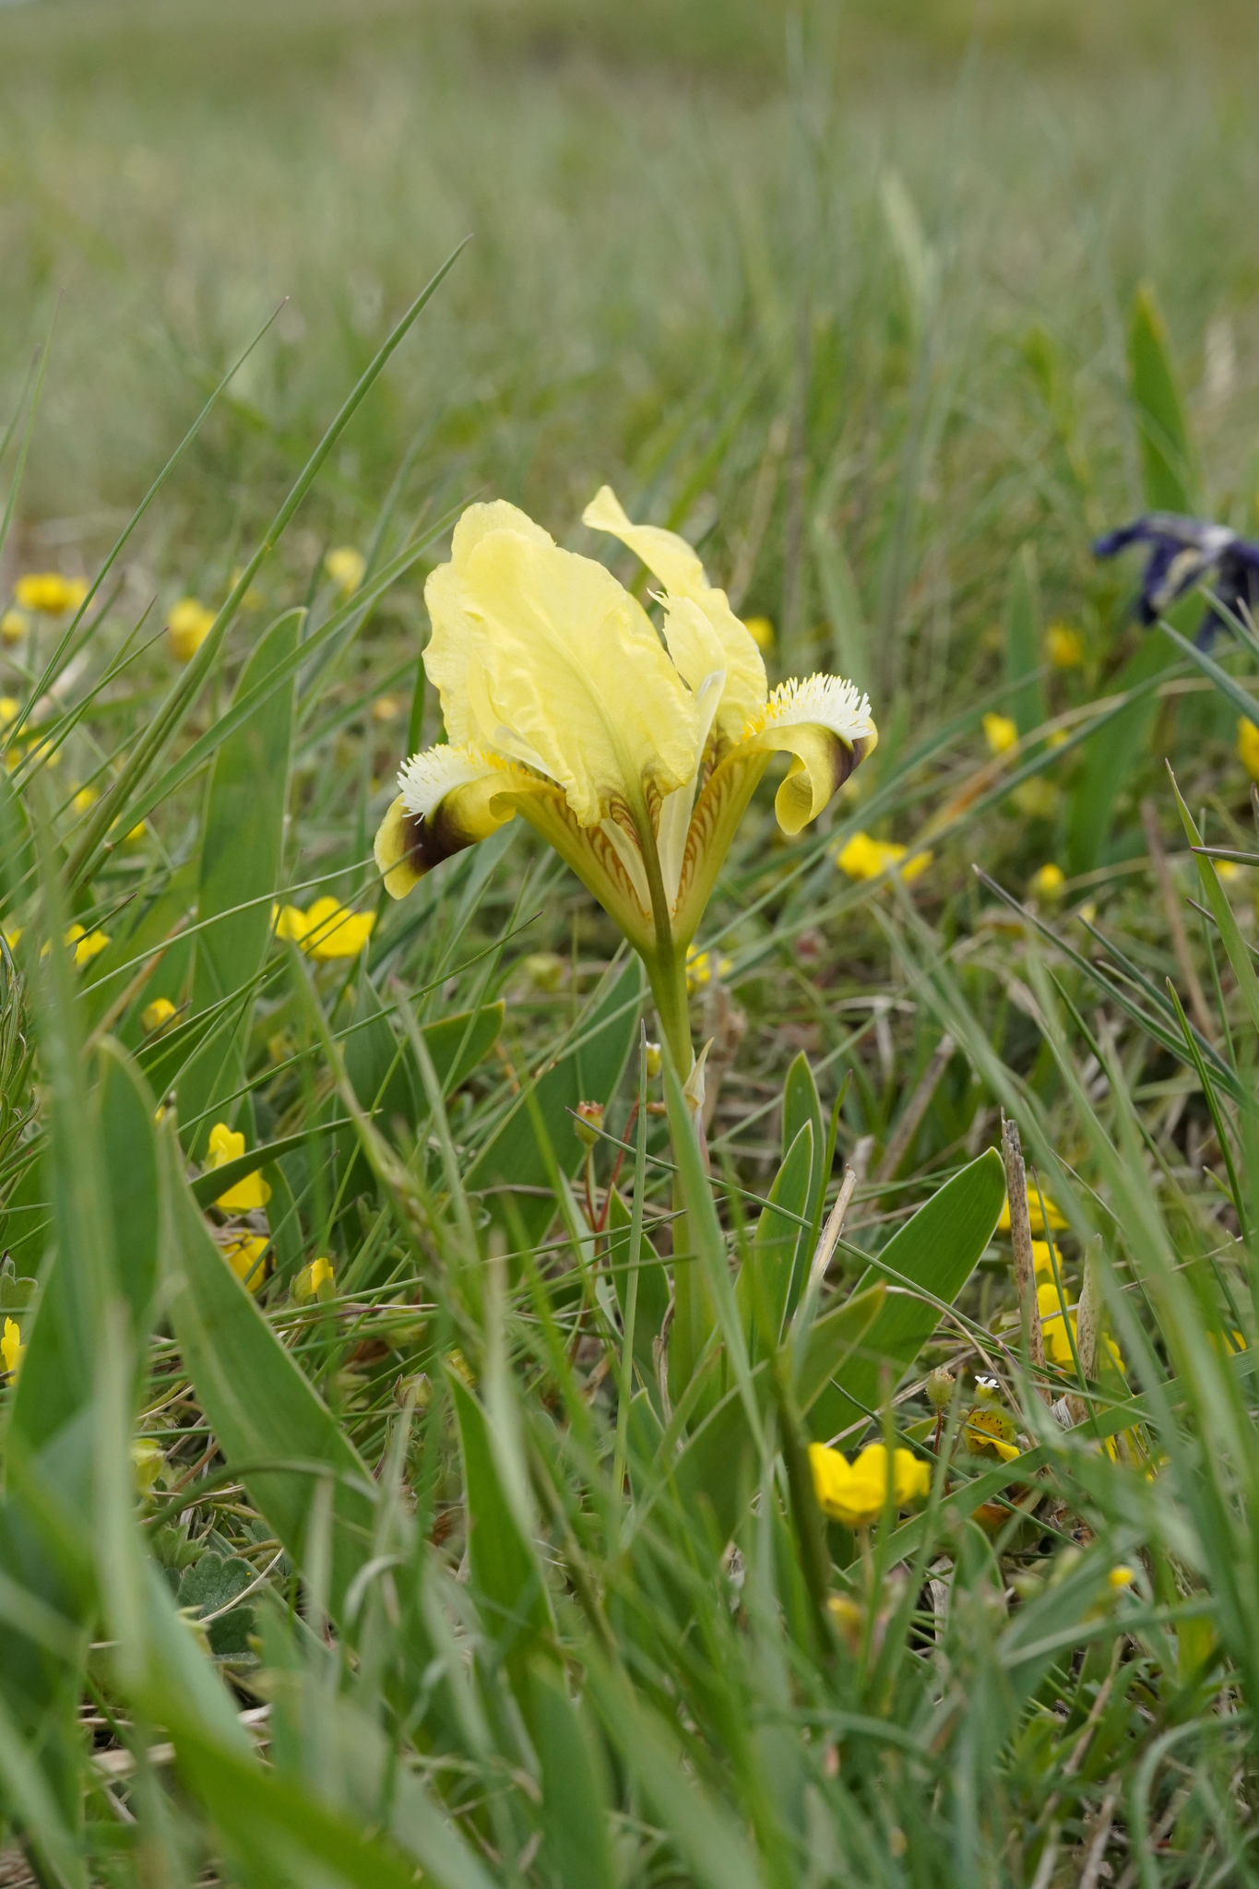
Iris pumila
Native range: central Europe to central Asia
Chromosomes: tetraploid
4n = 32 PPPP
Notable traits:
More or less stemless
Dark “pumila spot”
Very cold-hardy – at least USDA Zone 4
Crossed with TBs to create SDBs
Backcrossed with SDBs to create novel MDBs
©© Tobias Gratzer
via iNaturalist

Slide 12
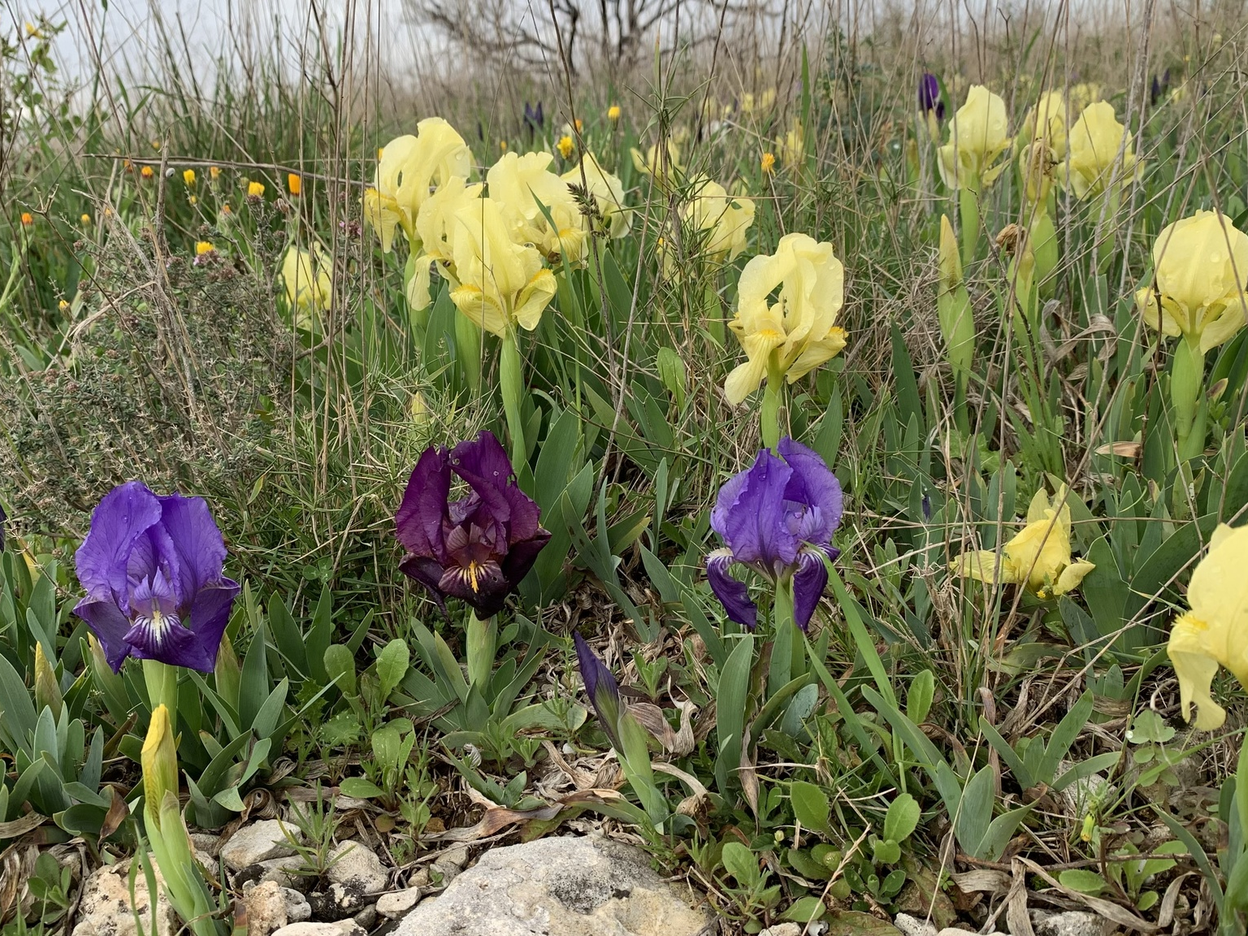
Iris lutescens
© fabienne niebler
via iNaturalist

Slide 13
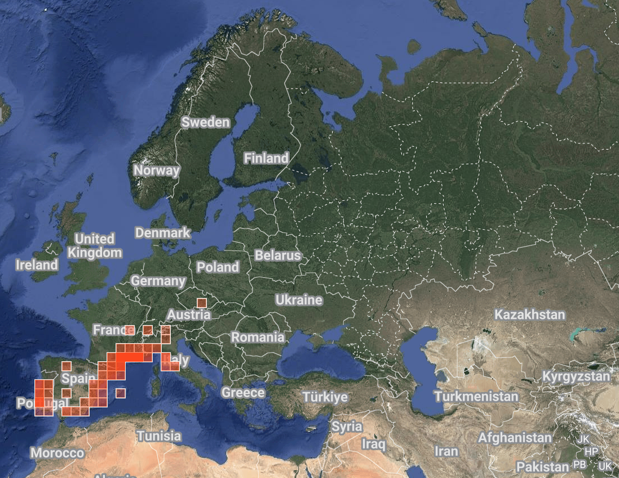
Iris lutescens
© fabienne niebler
via iNaturalist

Slide 14
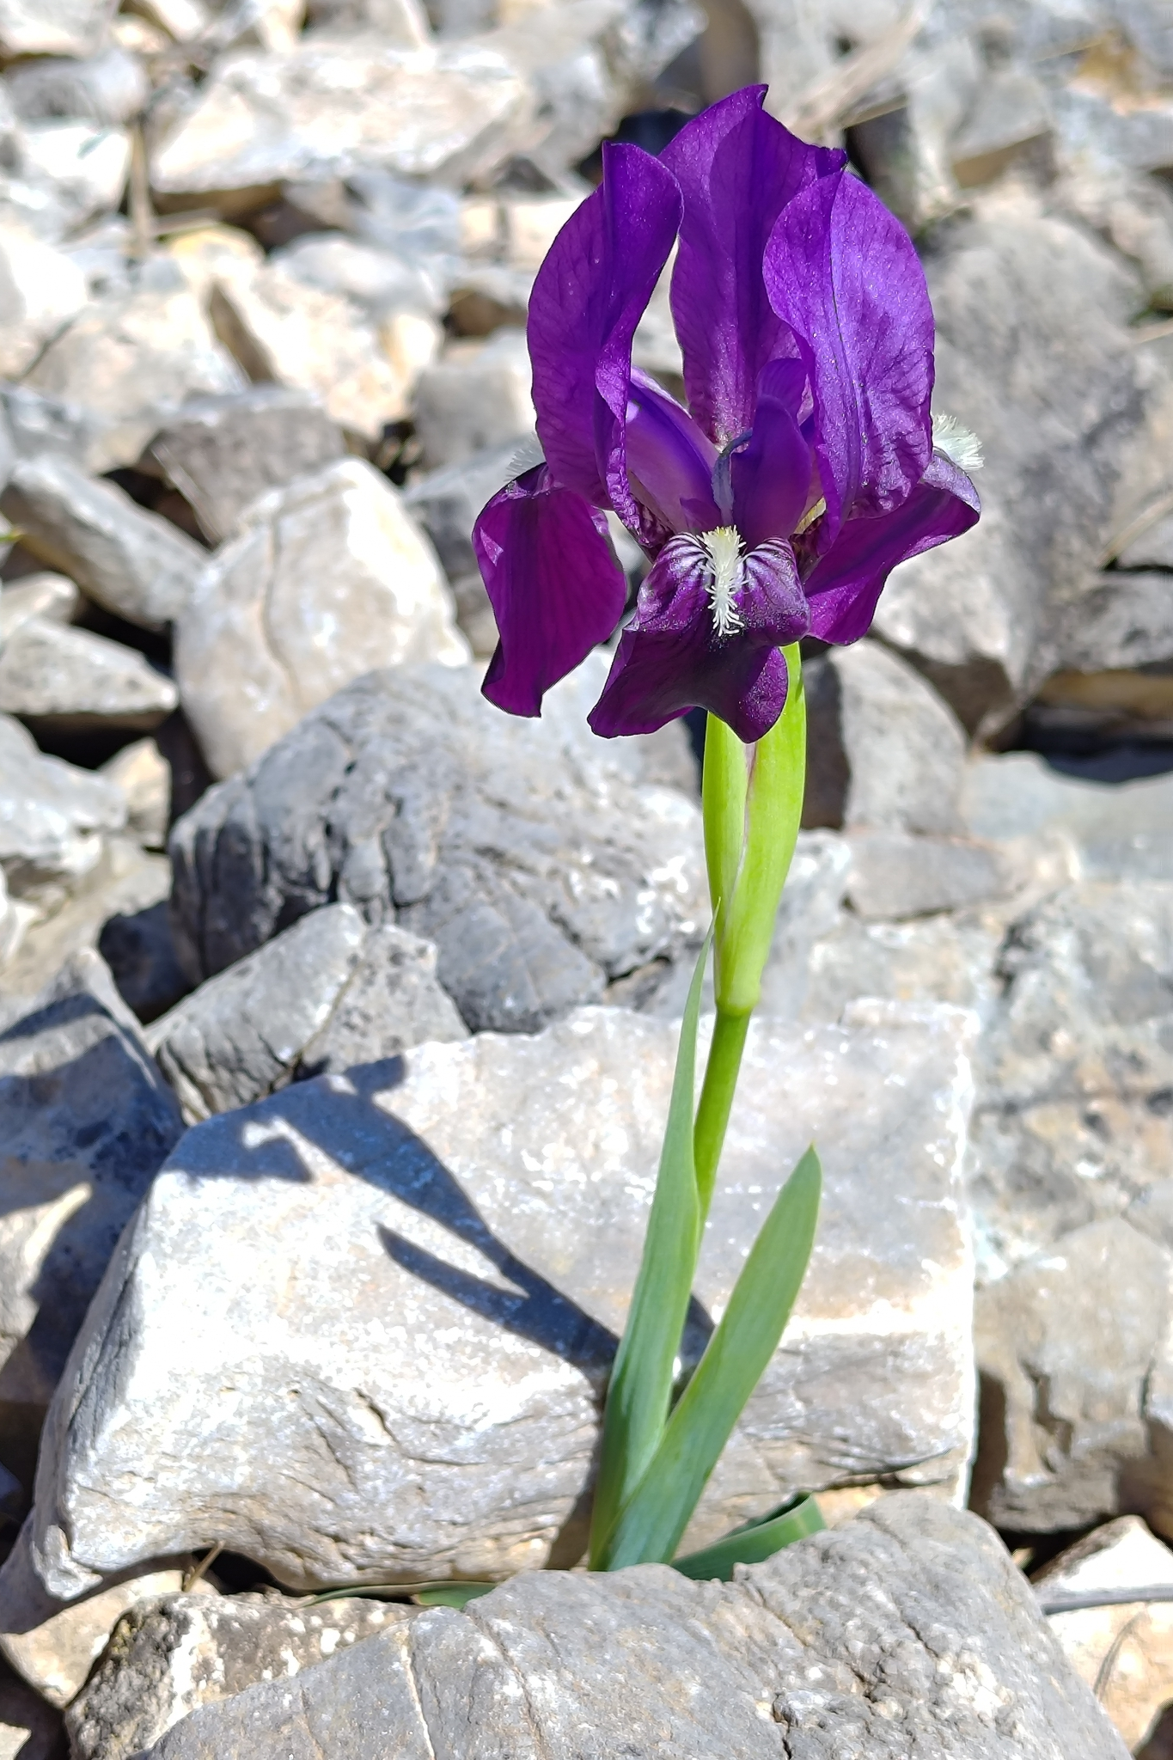
Iris lutescens
Native range: eastern Mediterranean coast
Chromosomes: tetraploid
4n = 40 = 16 + 24 PPTT
Notable traits:
Chromosomes are the same configuration as SDBs which are created by crossing Iris pumila with a tetraploid TB
Often stemmed, and tall forms may commonly exceed 8 inches
Short forms may lack a stem and were historically known as Iris chamaeiris
© yellowaspentree
via iNaturalist

Slide 15
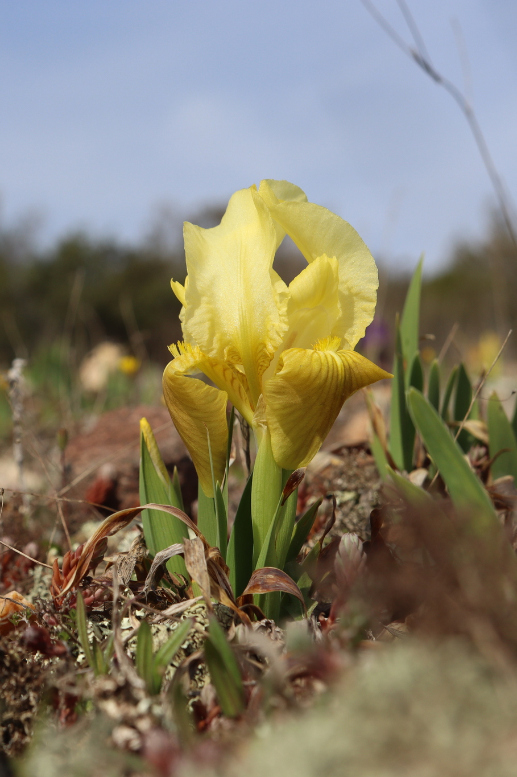
Iris lutescens
Native range: eastern Mediterranean coast
Chromosomes: tetraploid
4n = 40 = 16 + 24 PPTT
Notable traits:
Chromosomes are the same configuration as SDBs which are created by crossing Iris pumila with a tetraploid TB
Often stemmed, and tall forms may commonly exceed 8 inches
Short forms may lack a stem, and were historically known as Iris chamaeiris
© Mathis
via iNaturalist

Slide 16
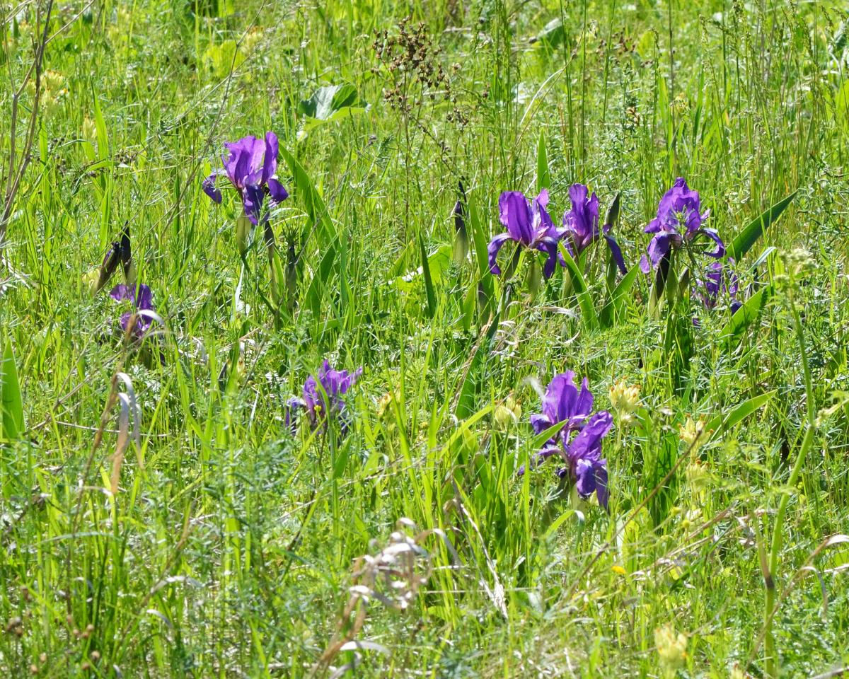
Iris aphylla
© Fyodor Pudovikov
via iNaturalist

Slide 17
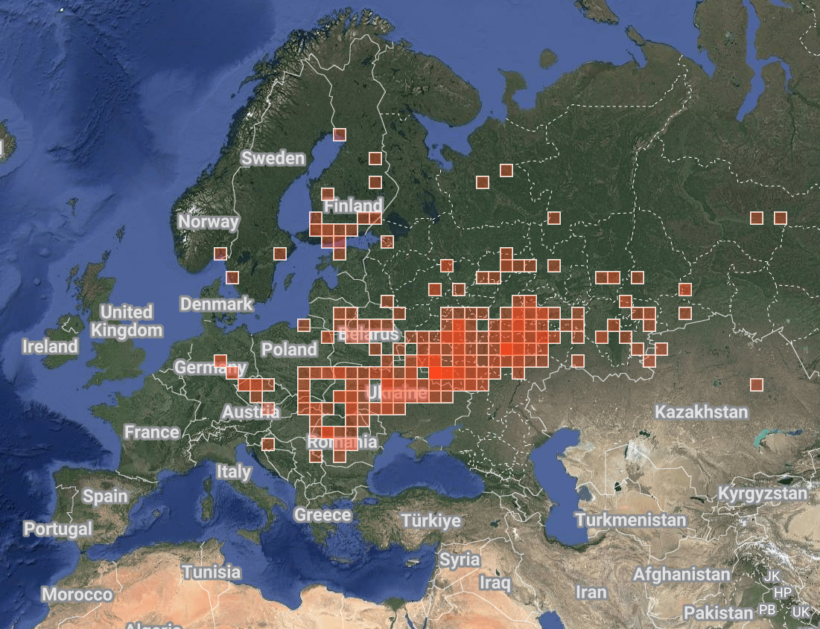
Iris aphylla
© Fyodor Pudovikov
via iNaturalist

Slide 18
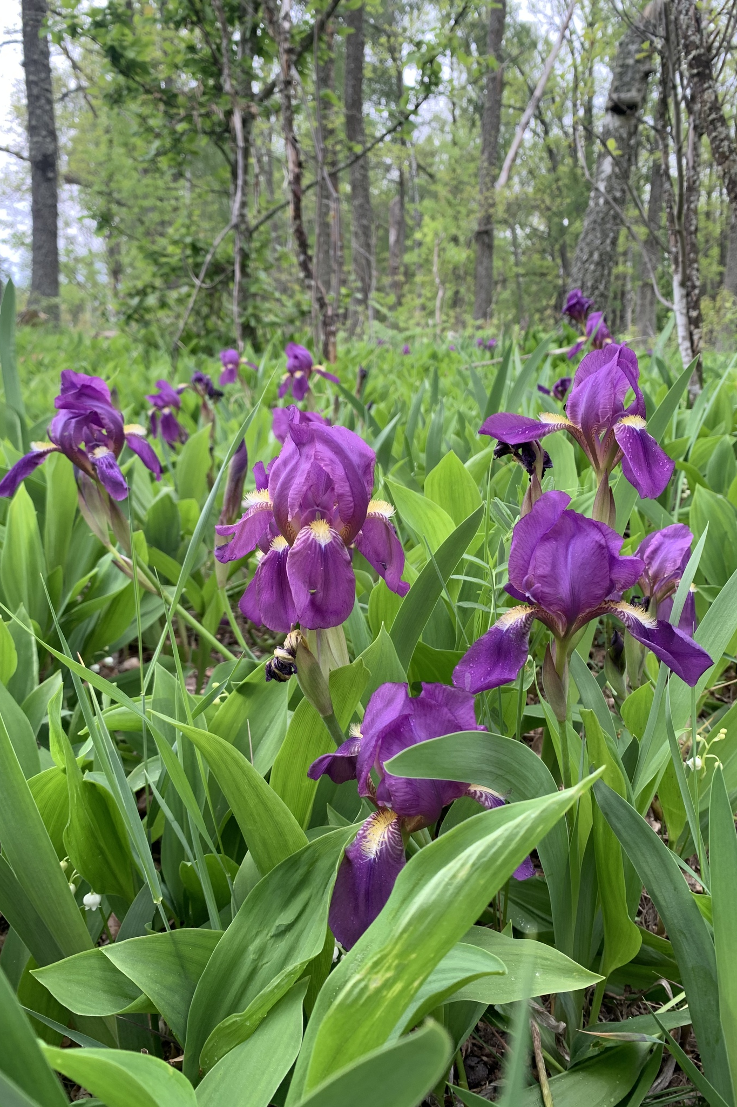
Iris aphylla
Native range: central Europe to central Asia
Chromosomes: tetraploid
4n = 48 TTTT
Notable traits:
Chromosomes are the same configuration as tetraploid TBs
Stems branch near ground level and flowers are held below the leaves
Very cold-hardy, and rhizomes are completely leafless in winter
Hager used this species in MDB breeding
© Oksana Barabanova
via iNaturalist

Slide 19
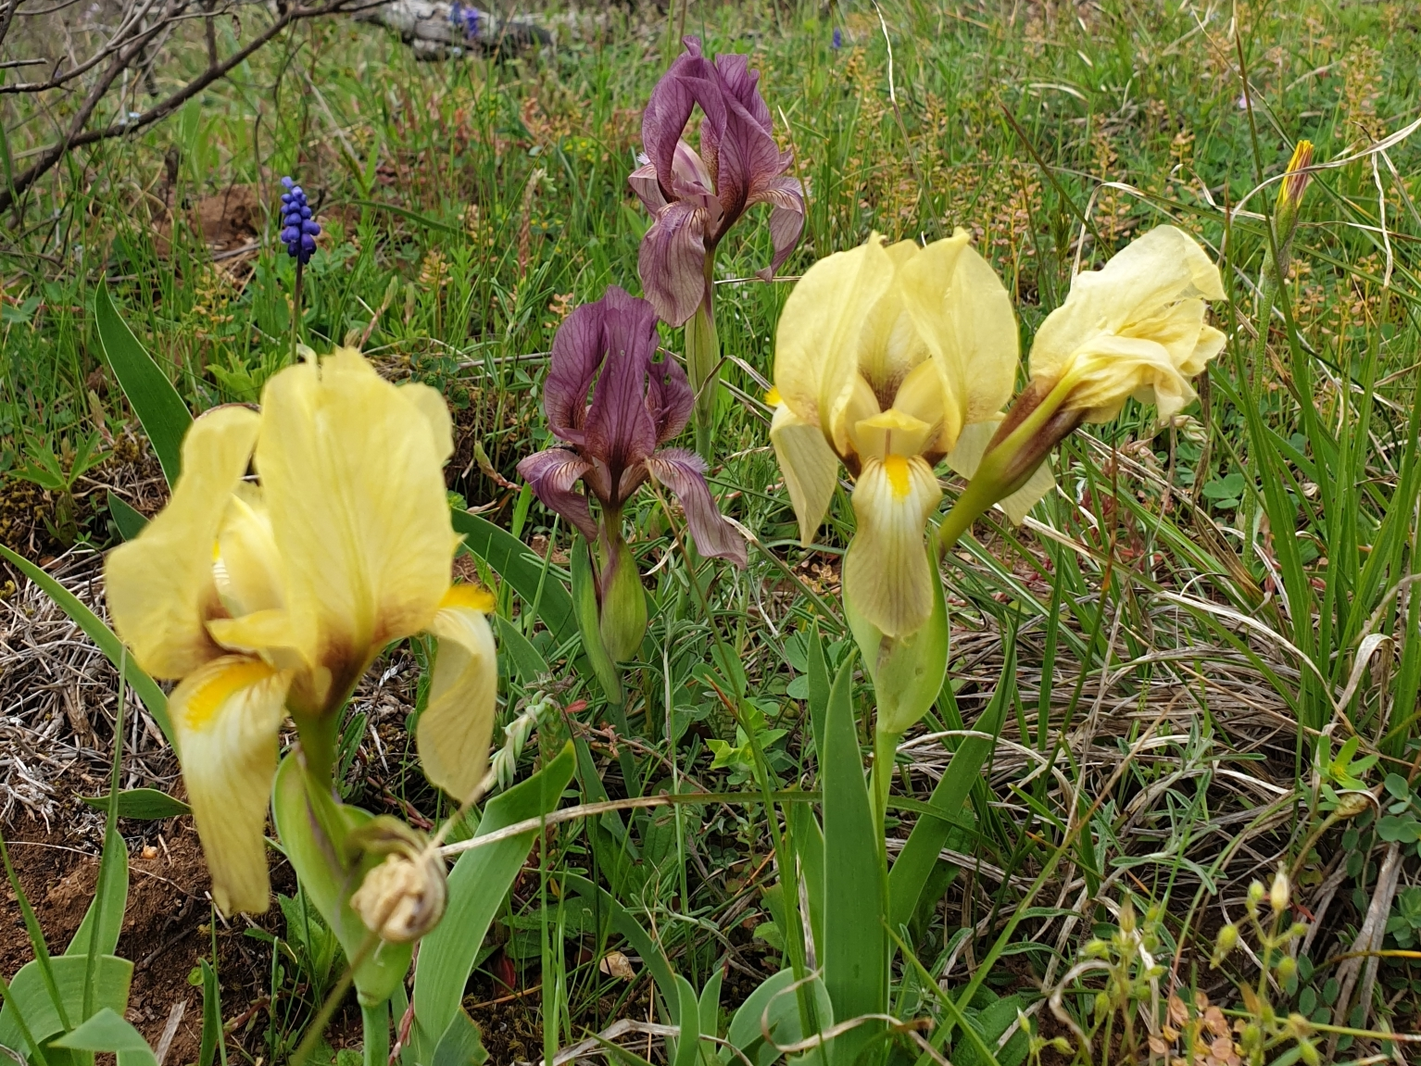
Iris reichenbachii
© Athina Papadopoulou
via iNaturalist

Slide 20
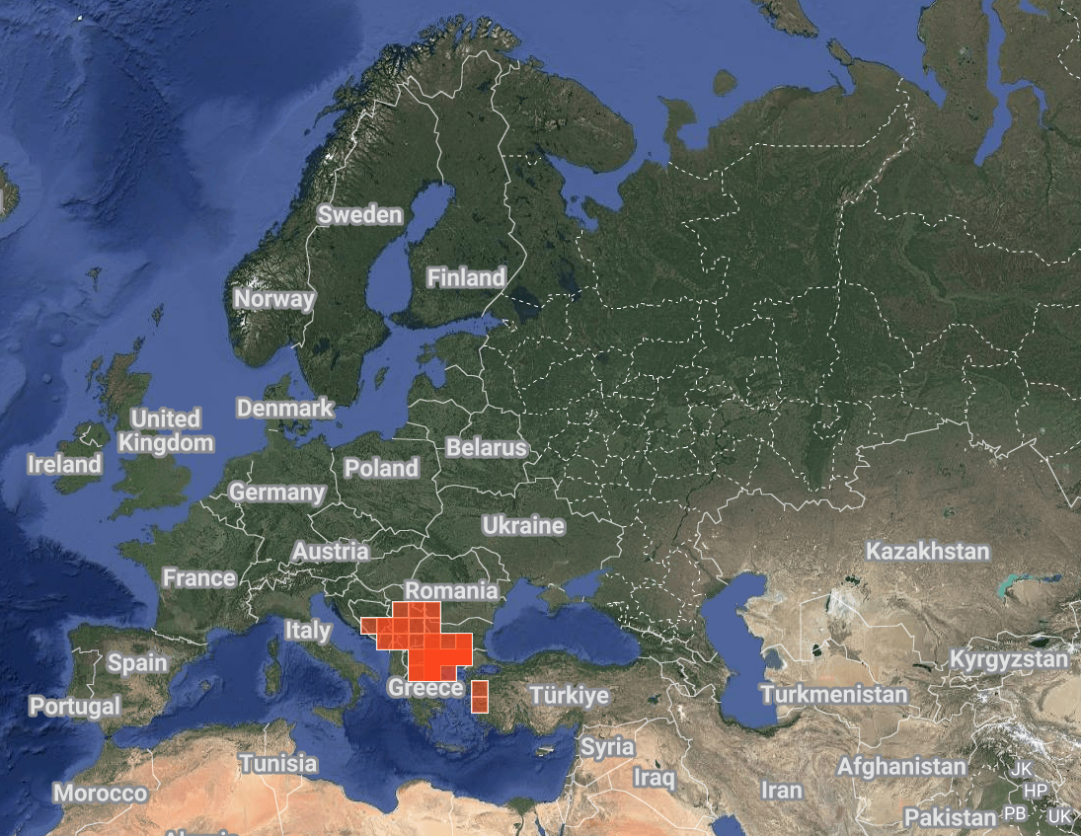
Iris reichenbachii
© Athina Papadopoulou
via iNaturalist

Slide 21
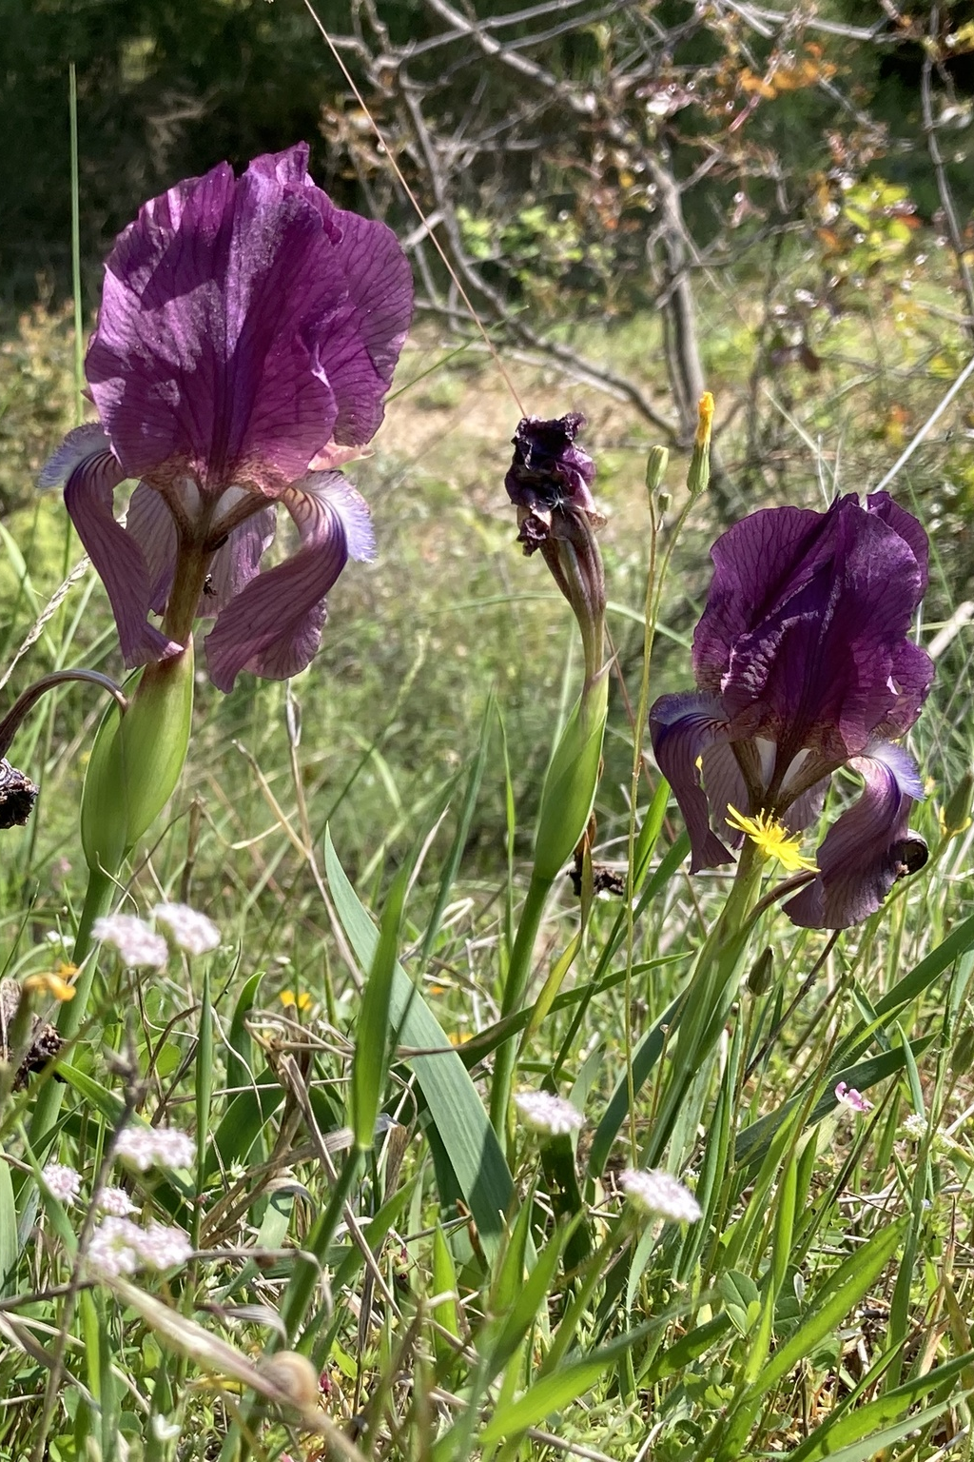
Iris reichenbachii
Native range: Balkan Peninsula
Chromosomes: diploid 2n = 24 or tetraploid 4n = 48 TT or TTTT
Notable traits:
Chromosomes are the same configuration as diploid or tetraploid TBs
Both spathes keeled
Stemmed, unlike Iris suaveolens
Contributed the dominant amoena mutation to TBs via ‘Progenitor’
© Cosmin Manci
via iNaturalist

Slide 22
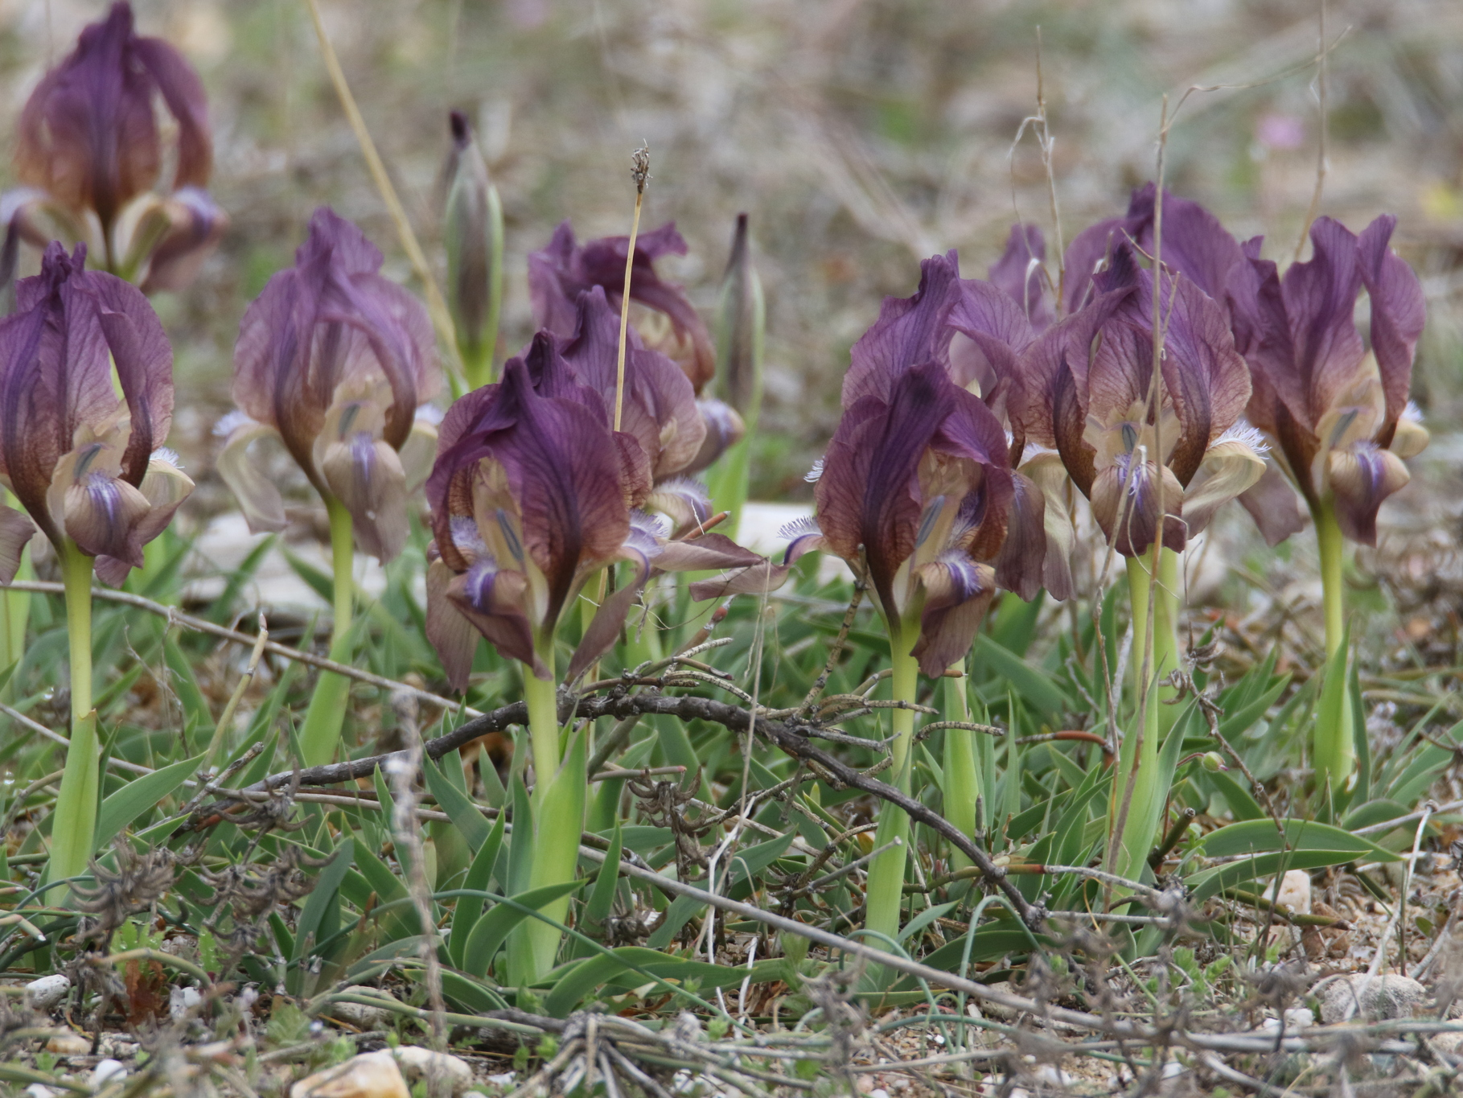
Iris suaveolens
© dimitriskokkinidis
via iNaturalist

Slide 23
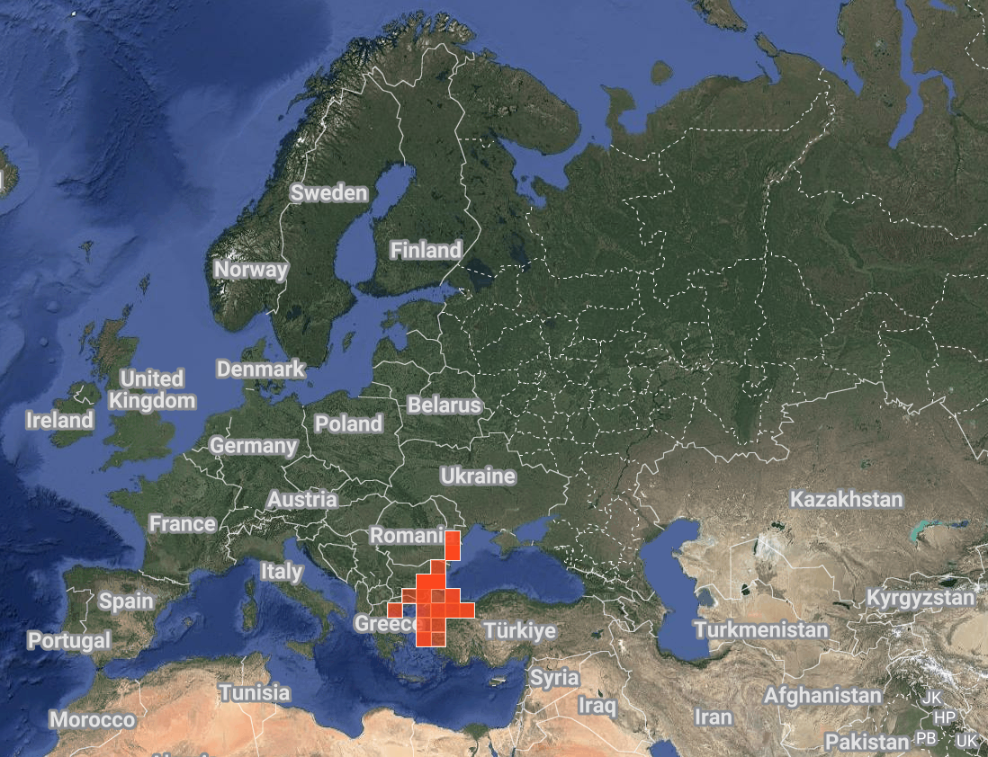
Iris suaveolens
© dimitriskokkinidis
via iNaturalist

Slide 24
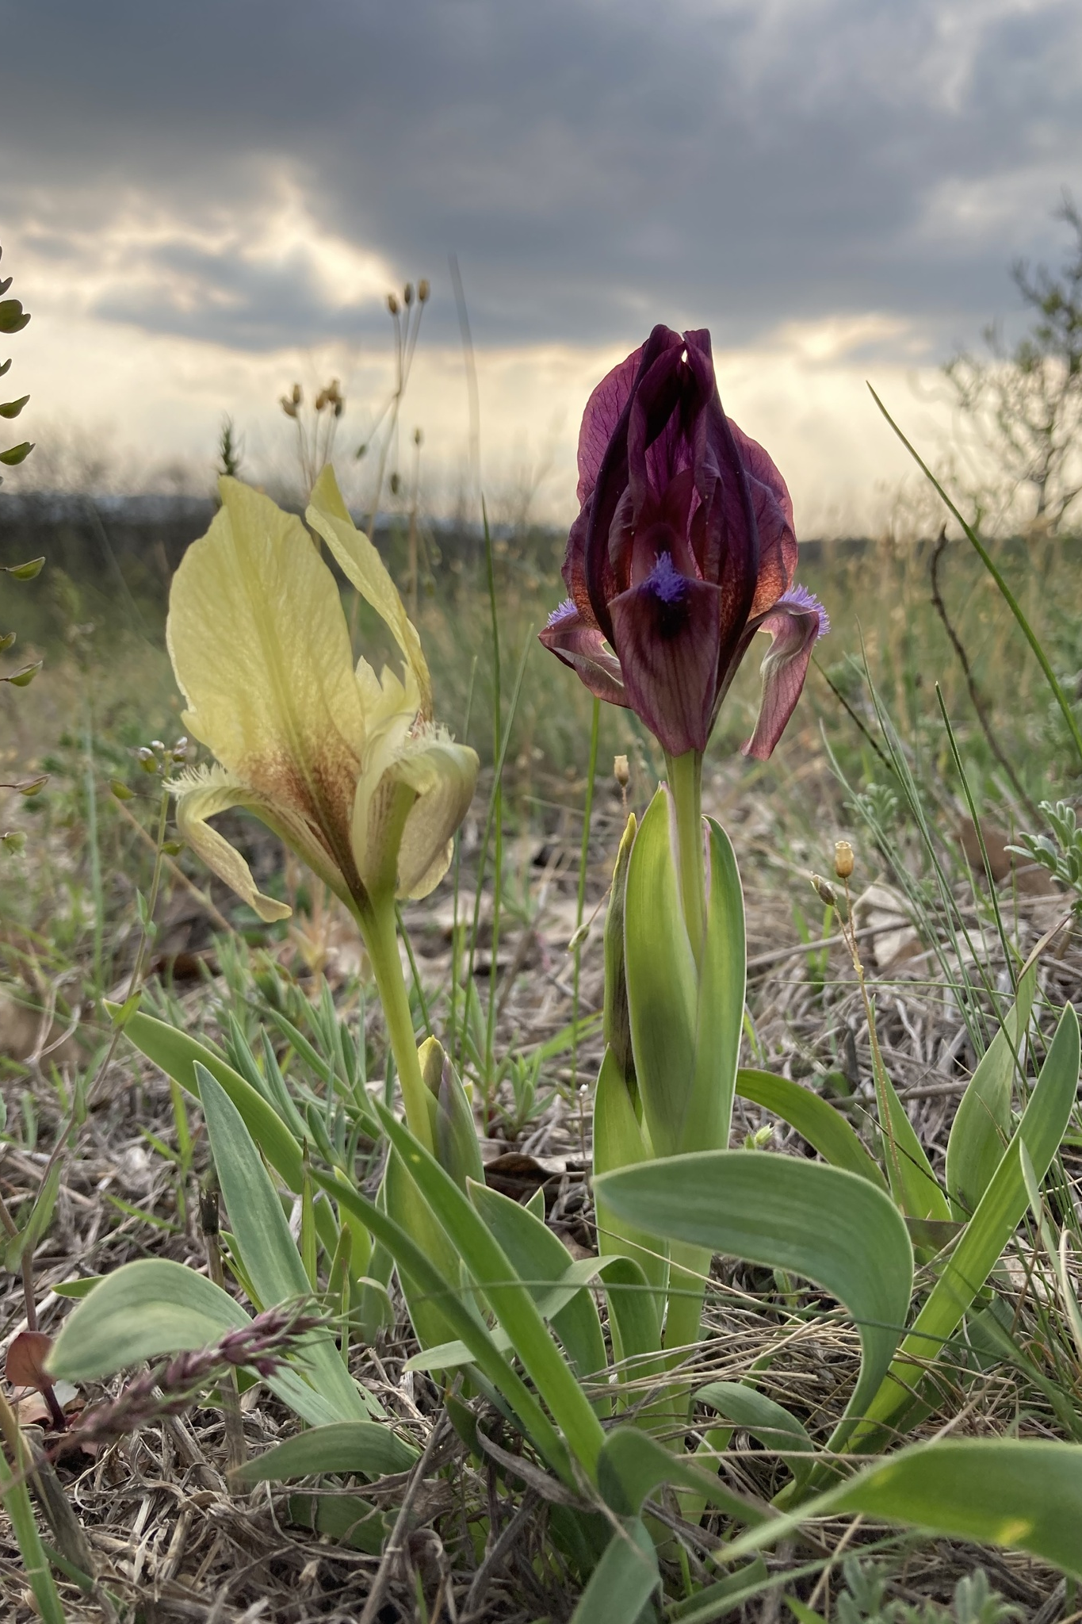
Iris suaveolens
Native range: Balkan Peninsula, Turkey
Chromosomes:
diploid 2n = 24 TT
Notable traits:
Chromosomes are the same configuration as diploid TBs
Very short, arched leaves and keeled spathes
Stemless, unlike Iris reichenbachii
Some diploid TB hybrids in the 60s and 70s – e.g. ’Buddha Song’ (Dunbar 1969)
© Cosmin Manci
via iNaturalist

